Slide 1
NOTE TO THE TEACHER
• This is YOUR lesson! Feel free to delete, change, or add any slides. • The purpose of these slides is to maximize verbal and written academic language from students. Depending on the length and other content of your lesson, some of the slides might not fit in with the content or the timing of the lesson. Each structured conversation should take 3-5 minutes, with the option of extending the conversation based on students’ responses. • It is recommended that some kind of objectives are displayed (such as in Slide 4), and that students interact with these objectives in some way (such as in Slide 5). • To customize each structured conversation, move the brackets to the appropriate icon.
Explanation on how to use these slides.
Disclaimer: As license holder of this product, you agree to that (1) you may use this digital product for your own use as an educator with your students and (2) you may not republish, reproduce, duplicate, copy, sell, display, or distribute to friends, colleagues, or any other third party. Any unauthorized use of the materials will constitute infringement of our rights.

Slide 3
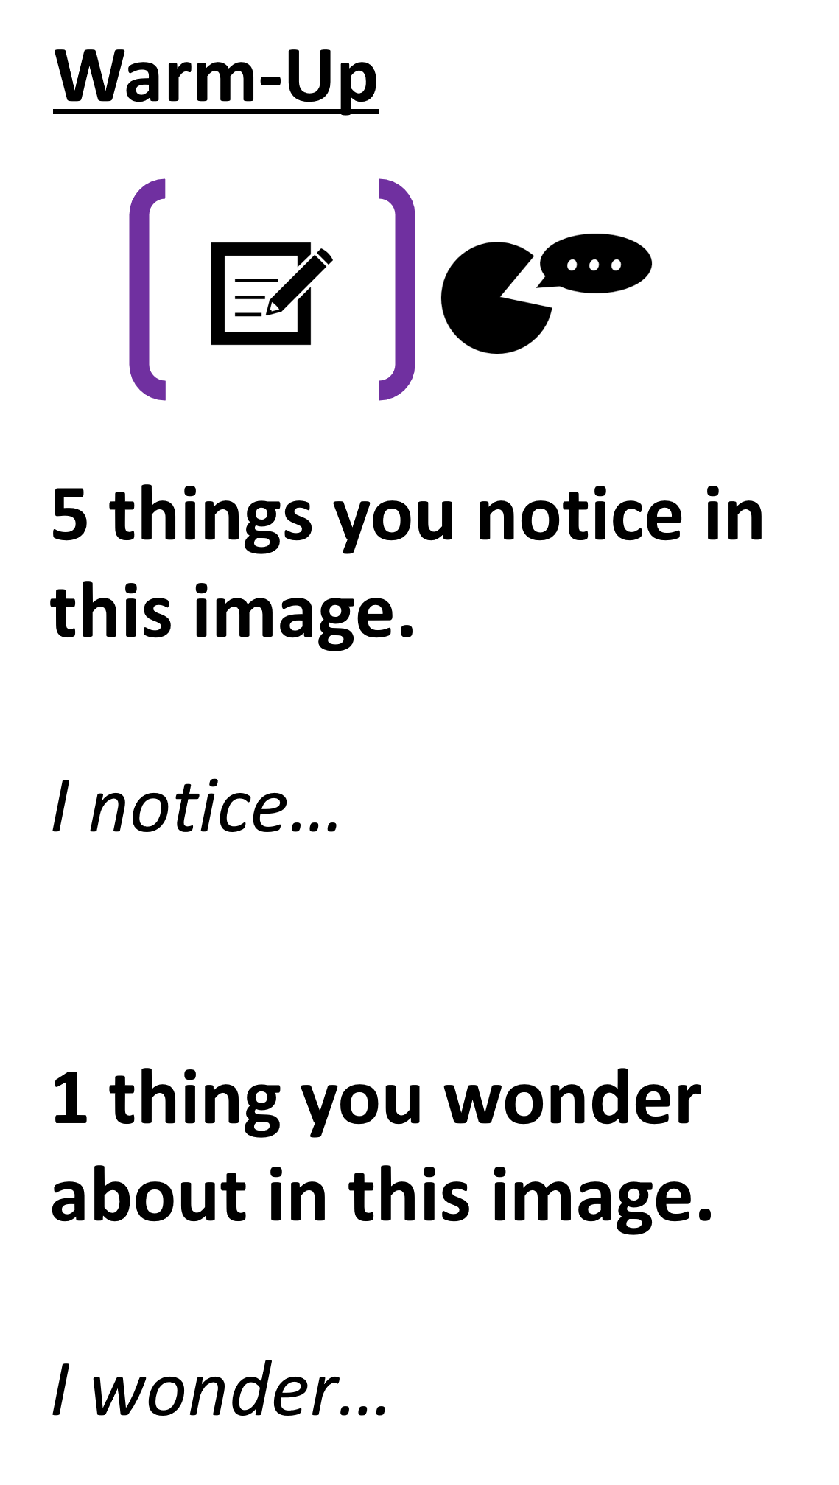
Notes:
This can be done independently, with a partner, or students can create individual lists and then share with a partner.

Slide 4
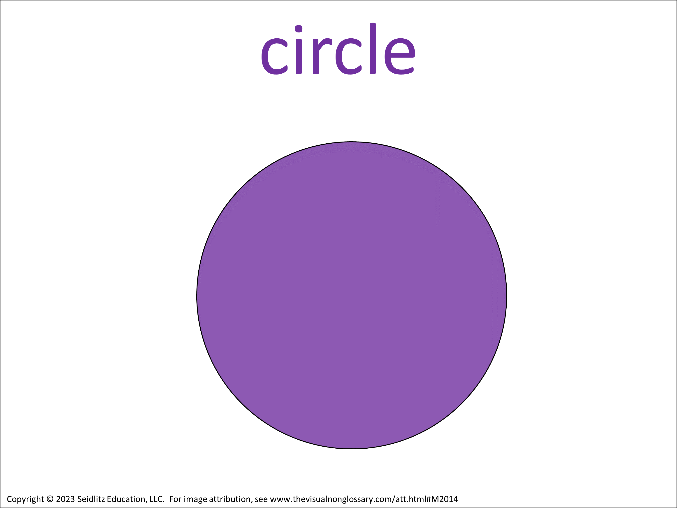
Content Objective
Today we are learning about cone.
Language Objective
In complete sentences: Why could someone say that a cone does not have a vertex? Someone could say that a cone does not have a vertex because... Use the vocabulary words to the right in your response.
Notes:
It is recommended that the language objective is writing (for Grades 2-12) with speaking occurring during structured conversations throughout the lesson.
The content objective can be edited to use the specific verbiage of the learning standard. Note: these objectives are simplified for easier implementation. For more information about content and language objectives, see 7 Steps to a Language-Rich Interactive Classroom by John Seidlitz & Bill Perryman (p.118-123).

Slide 5
Why could someone say that a cone does not have a vertex?
Choose a sentence stem to share:
• I think the question is asking...
• I think that the word ____ means... because...
• The picture makes me think of... because...
Notes:
Introductory Structured Conversation:
This activity is called Gearing Up for the Guiding Question and is described in more detail in Teaching Science to English Learners by Stephen Fleenor and Tina Beene (p.24-25).

Slide 6
Notes:
Print this slide out and display it on your word wall, or use this image to as a simplified scaffold in structured conversations.

Slide 7
Notes:
Print this slide out and display it on your word wall, or use this image to as a simplified scaffold in structured conversations.

Slide 8
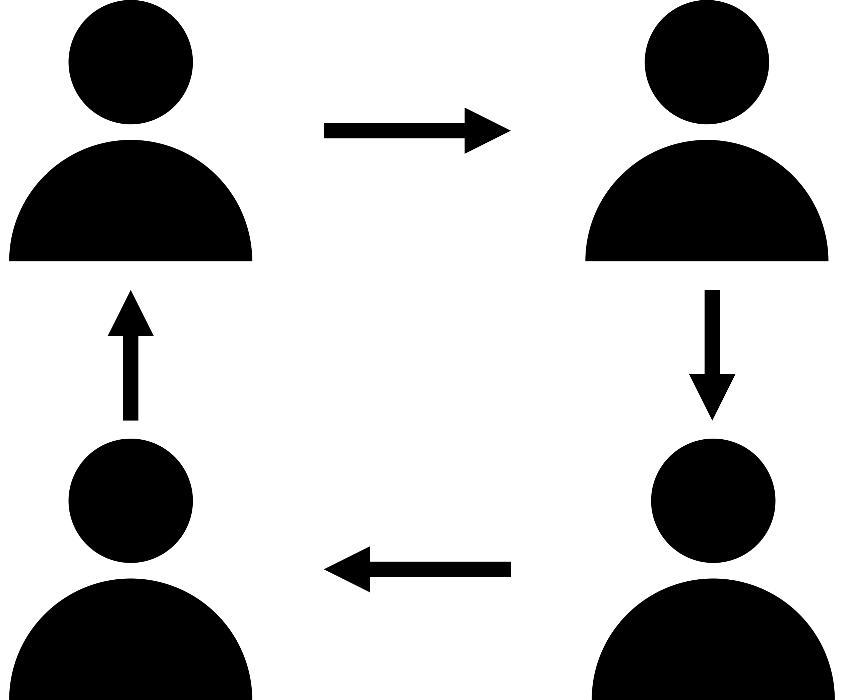
Observational Question
What is a cone?
A cone is...
Signal:
Share:
Goes 1ˢᵗ:
A
Assess:
Notes:
Structured Conversations:
This activity is called QSSSA and is described in more detail in Teaching Science to English Learners by Stephen Fleenor and Tina Beene (p.29)
Script:
• Class, let’s pronounce this word out loud: (read vocabulary word out loud slowly). • Can everyone (raise a thumb/stand up/raise your hand/put your hand on your head)? Think about this question, when you are ready to answer this question, (lower your hand/sit down). • You are going to share with (shoulder partner/table group/away partner) The person in your group that will go first is the person (with the longest hair/with the shortest hair/with the brightest shirt/with the darkest shirt/[letter designation within the table group]/closest to the door/closest to the window). • [Students share with their partners/groups. When ~50% of the class is no longer discussing the content, bring everyone back together.] • I’m going to (call on some students randomly/call on one person with each group [perhaps using one of the “Goes 1ˢᵗ” designations]/have everyone write down their response).

Slide 9
Observational Question
What is a circle?
A circle is...
Signal:
Share:
Goes 1ˢᵗ:
A
Assess:
Notes:
Structured Conversations:
This activity is called QSSSA and is described in more detail in Teaching Science to English Learners by Stephen Fleenor and Tina Beene (p.29)
Script:
• Class, let’s pronounce this word out loud: (read vocabulary word out loud slowly). • Can everyone (raise a thumb/stand up/raise your hand/put your hand on your head)? Think about this question, when you are ready to answer this question, (lower your hand/sit down). • You are going to share with (shoulder partner/table group/away partner) The person in your group that will go first is the person (with the longest hair/with the shortest hair/with the brightest shirt/with the darkest shirt/[letter designation within the table group]/closest to the door/closest to the window). • [Students share with their partners/groups. When ~50% of the class is no longer discussing the content, bring everyone back together.] • I’m going to (call on some students randomly/call on one person with each group [perhaps using one of the “Goes 1ˢᵗ” designations]/have everyone write down their response).

Slide 10
Relational Question
How is a cone related to a circle?
A cone is related to a circle because...
Signal:
Share:
Goes 1ˢᵗ:
A
Assess:
Notes:
Structured Conversations:
This activity is called QSSSA and is described in more detail in Teaching Science to English Learners by Stephen Fleenor and Tina Beene (p.29)
Script:
• Can everyone (raise a thumb/stand up/raise your hand/put your hand on your head)? Think about this question, when you are ready to answer this question, (lower your hand/sit down). • You are going to share with (shoulder partner/table group/away partner) The person in your group that will go first is the person (with the longest hair/with the shortest hair/with the brightest shirt/with the darkest shirt/[letter designation within the table group]/closest to the door/closest to the window). • [Students share with their partners/groups. When ~50% of the class is no longer discussing the content, bring everyone back together.] • I’m going to (call on some students randomly/call on one person with each group [perhaps using one of the “Goes 1ˢᵗ” designations]/have everyone write down their response).

Slide 11
Relational Question
How is a cone related to a circle?
A cone is related to a circle because...
Signal:
Share:
Goes 1ˢᵗ:
A
Assess:
Notes:
Structured Conversations:
This activity is called QSSSA and is described in more detail in Teaching Science to English Learners by Stephen Fleenor and Tina Beene (p.29)
Script:
• Can everyone (raise a thumb/stand up/raise your hand/put your hand on your head)? Think about this question, when you are ready to answer this question, (lower your hand/sit down). • You are going to share with (shoulder partner/table group/away partner) The person in your group that will go first is the person (with the longest hair/with the shortest hair/with the brightest shirt/with the darkest shirt/[letter designation within the table group]/closest to the door/closest to the window). • [Students share with their partners/groups. When ~50% of the class is no longer discussing the content, bring everyone back together.] • I’m going to (call on some students randomly/call on one person with each group [perhaps using one of the “Goes 1ˢᵗ” designations]/have everyone write down their response).

Slide 12
Observational Question
What is a vertex?
A vertex is...
Signal:
Share:
Goes 1ˢᵗ:
A
Assess:
Notes:
Structured Conversations:
This activity is called QSSSA and is described in more detail in Teaching Science to English Learners by Stephen Fleenor and Tina Beene (p.29)
Script:
• Class, let’s pronounce this word out loud: (read vocabulary word out loud slowly). • Can everyone (raise a thumb/stand up/raise your hand/put your hand on your head)? Think about this question, when you are ready to answer this question, (lower your hand/sit down). • You are going to share with (shoulder partner/table group/away partner) The person in your group that will go first is the person (with the longest hair/with the shortest hair/with the brightest shirt/with the darkest shirt/[letter designation within the table group]/closest to the door/closest to the window). • [Students share with their partners/groups. When ~50% of the class is no longer discussing the content, bring everyone back together.] • I’m going to (call on some students randomly/call on one person with each group [perhaps using one of the “Goes 1ˢᵗ” designations]/have everyone write down their response).

Slide 13
Inferential Question
Why could someone say that a cone does not have a vertex?
Someone could say that a cone does not have a vertex because...
Signal:
Share:
Goes 1ˢᵗ:
A
Assess:
Notes:
Structured Conversations:
This activity is called QSSSA and is described in more detail in Teaching Science to English Learners by Stephen Fleenor and Tina Beene (p.29)
Script:
• Can everyone (raise a thumb/stand up/raise your hand/put your hand on your head)? Think about this question, when you are ready to answer this question, (lower your hand/sit down). • You are going to share with (shoulder partner/table group/away partner) The person in your group that will go first is the person (with the longest hair/with the shortest hair/with the brightest shirt/with the darkest shirt/[letter designation within the table group]/closest to the door/closest to the window). • [Students share with their partners/groups. When ~50% of the class is no longer discussing the content, bring everyone back together.] • I’m going to (call on some students randomly/call on one person with each group [perhaps using one of the “Goes 1ˢᵗ” designations]/have everyone write down their response).

Slide 14
Extension
Draw what you think the rest of the image looks like for cone
Notes:
It is recommended that this activity is done as a warm-up before being introduced to the word, or as a review at the end of the lesson. This activity can be done independently or in groups.
This activity is called Complete the Pictured and is described in more detail in Teaching Science to English Learners by Stephen Fleenor and Tina Beene (p.30)

Slide 15
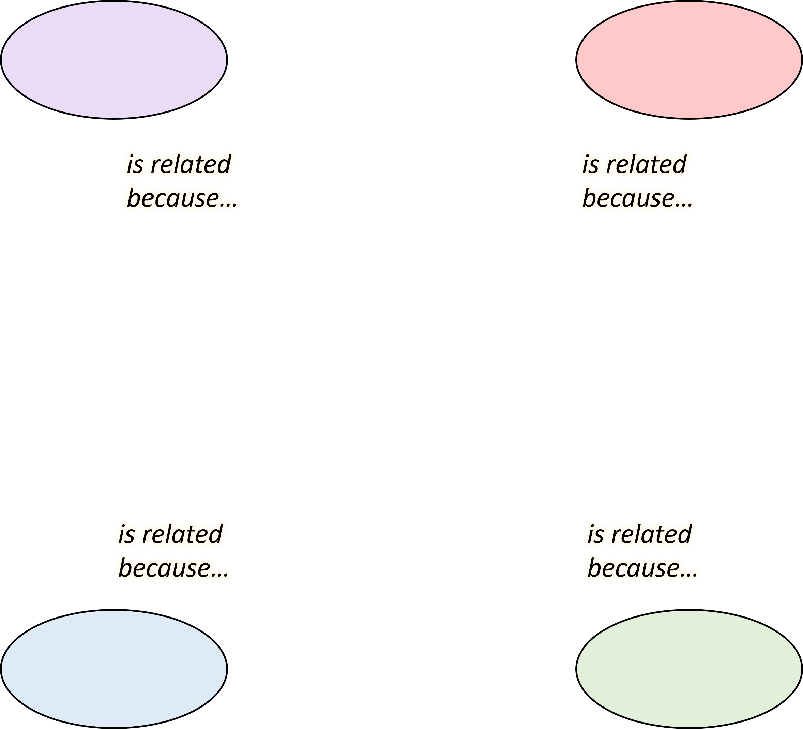
Extension
Make a word map connecting cone to 3-5 other vocabulary words.
Next to each connecting line, describe how the two words are related.
Work with a partner or share your word map with a partner when you finish.
Notes:
For example, if the central word is “atom”, a student might:
• Make a connection to “proton” and write “atoms contain protons” next to the connecting line. • Make a connection to “molecule” and write “atoms make up molecules” next to the connecting line. • Make a connection to “matter” and write “atoms are the smallest units of matter” next to the connecting line. • Make a connection to “nucleus” and write “the center of an atom is the nucleus” next to the connecting line. Alternatively, students can create a Vocab Connection Web (Teaching Science to English Learners by Fleenor and Beene, 2019, p.53) in which any connection can be made between any two words – there does not have a to a “central” word.

Slide 16
Extension
Write a paragraph describing cone. Include 3-5 other vocabulary words in your paragraph.
Notes:
When students are finished, it is recommended that they share their paragraphs with a partner or group, with time afterwards to make any edits to their paragraphs.

