Slide 1
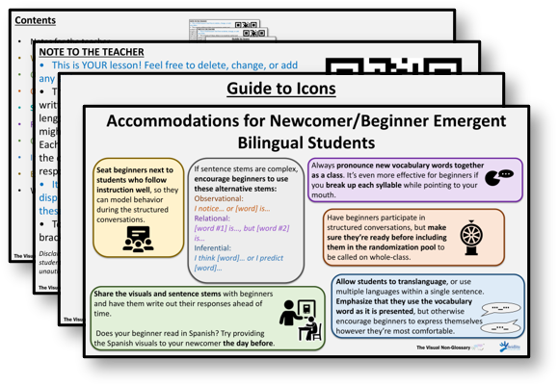
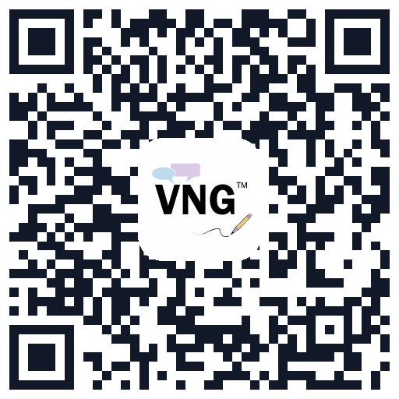
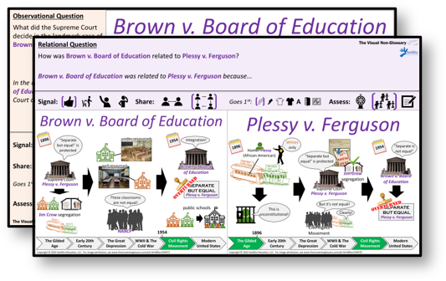

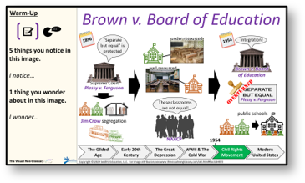
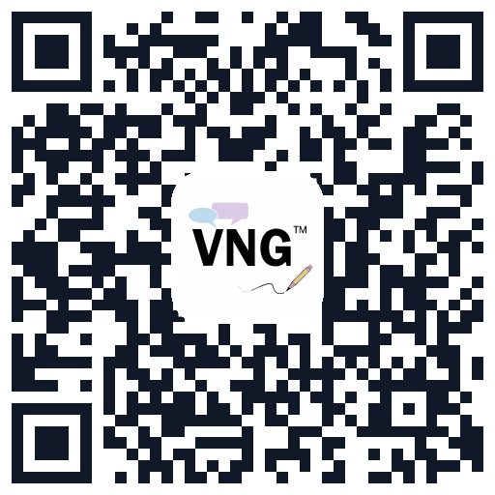
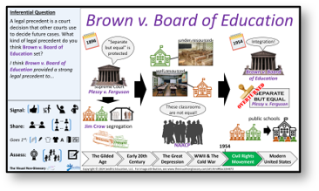
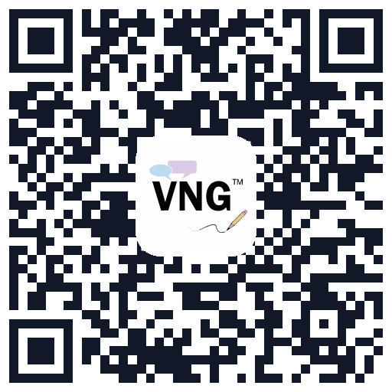
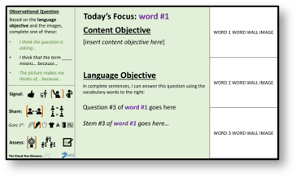
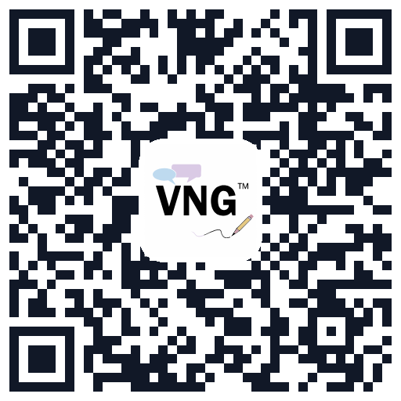
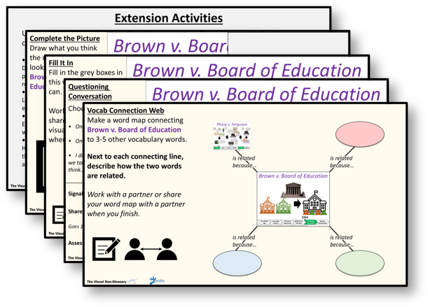
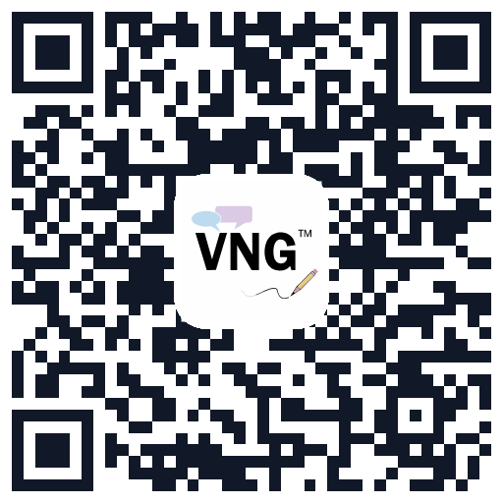
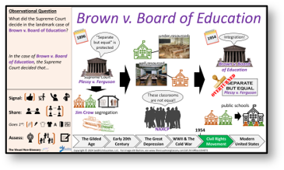
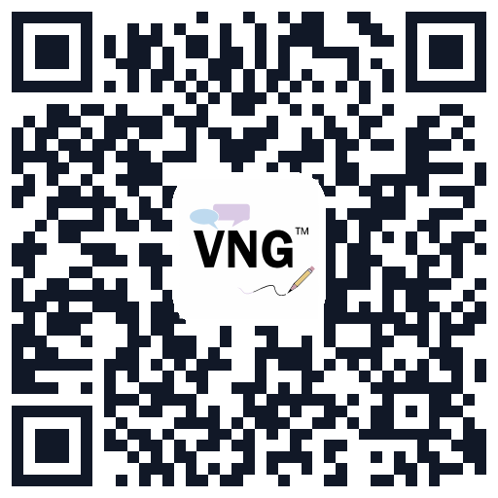
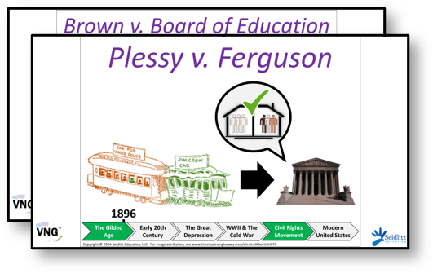
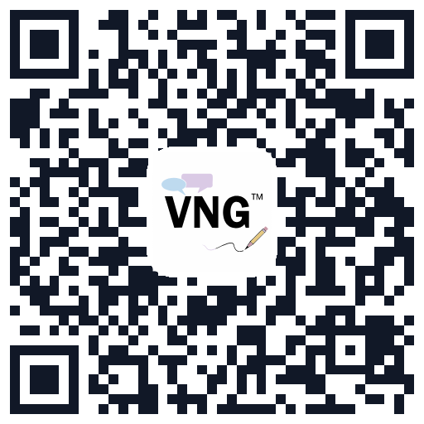


Navigating This Lesson
Notes for the Teacher
Relational Conversation
How to structure conversations and accommodate for students learning English.
Students describe the relationship between this term and another key term.
Jump to this slide
Show me
Jump to this slide
Show me
Warm-Up
Inferential Conversation + Exit Ticket
Have students write down and/or share with their partner what they notice and wonder about the visual.
Students discuss the exit ticket question then answer it in writing (Grades 2-12) or verbally (K-1).
Jump to this slide
Show me
Jump to this slide
Show me
Objectives Conversation
Extension Activities
Have students interact with the language of the lesson and introduce the exit ticket question.
Various activities that can be used at the beginning, middle, or end of the lesson, or as a unit review.
Jump to this slide
Show me
Jump to this slide
Show me
Observational Conversation
Word Wall Visuals
Students produce their own definitions to create a class-wide understanding of the term.
Print these out and add to the unit’s word wall as you progress through the unit.
Jump to this slide
Show me
Jump to this slide
Show me
Notes:
For the teacher, not to be displayed to students.

Slide 2
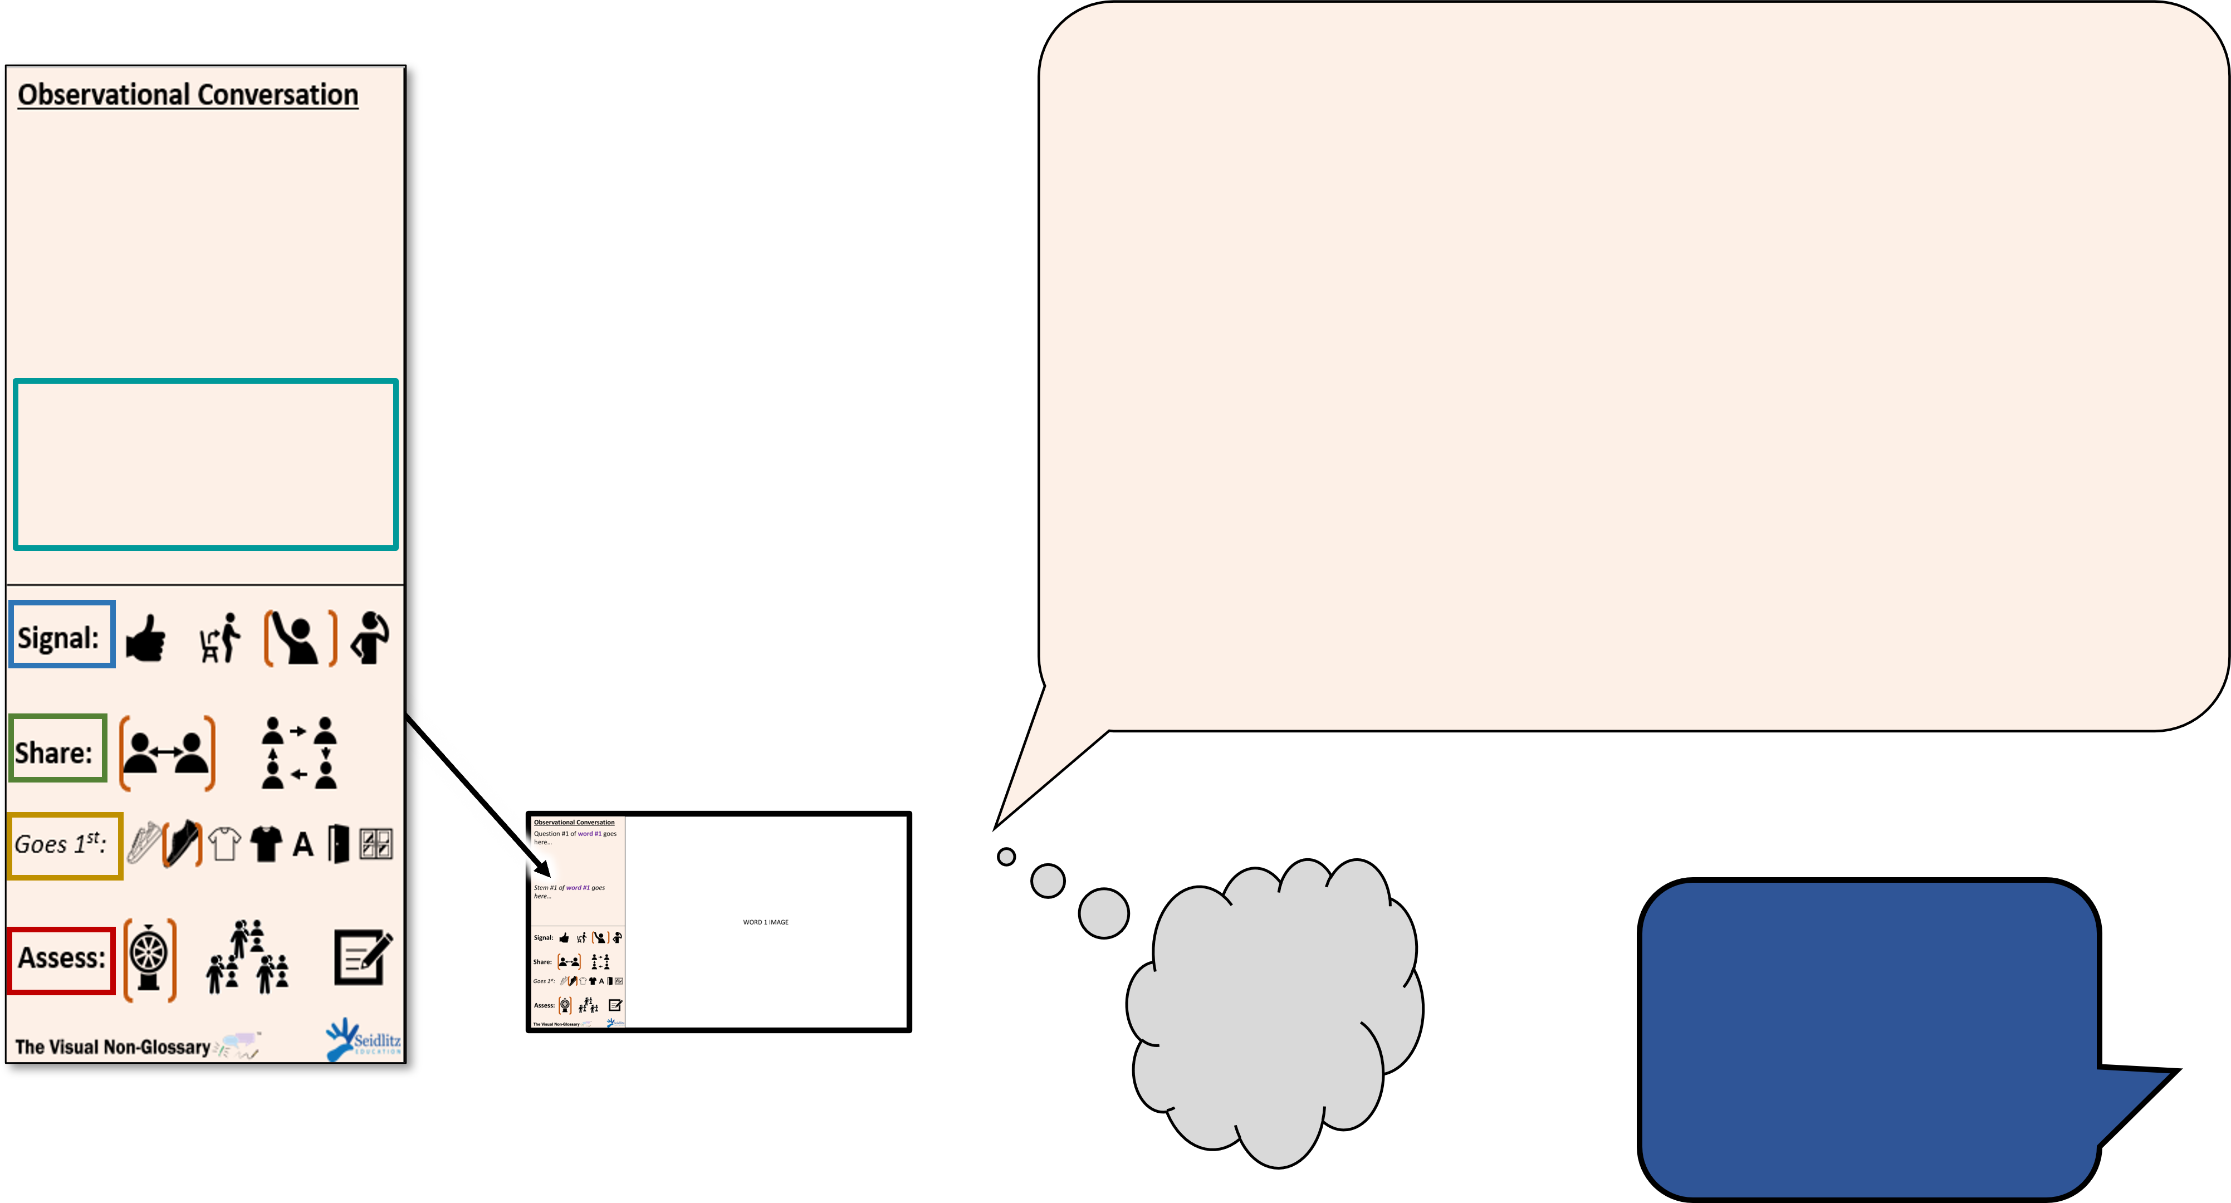

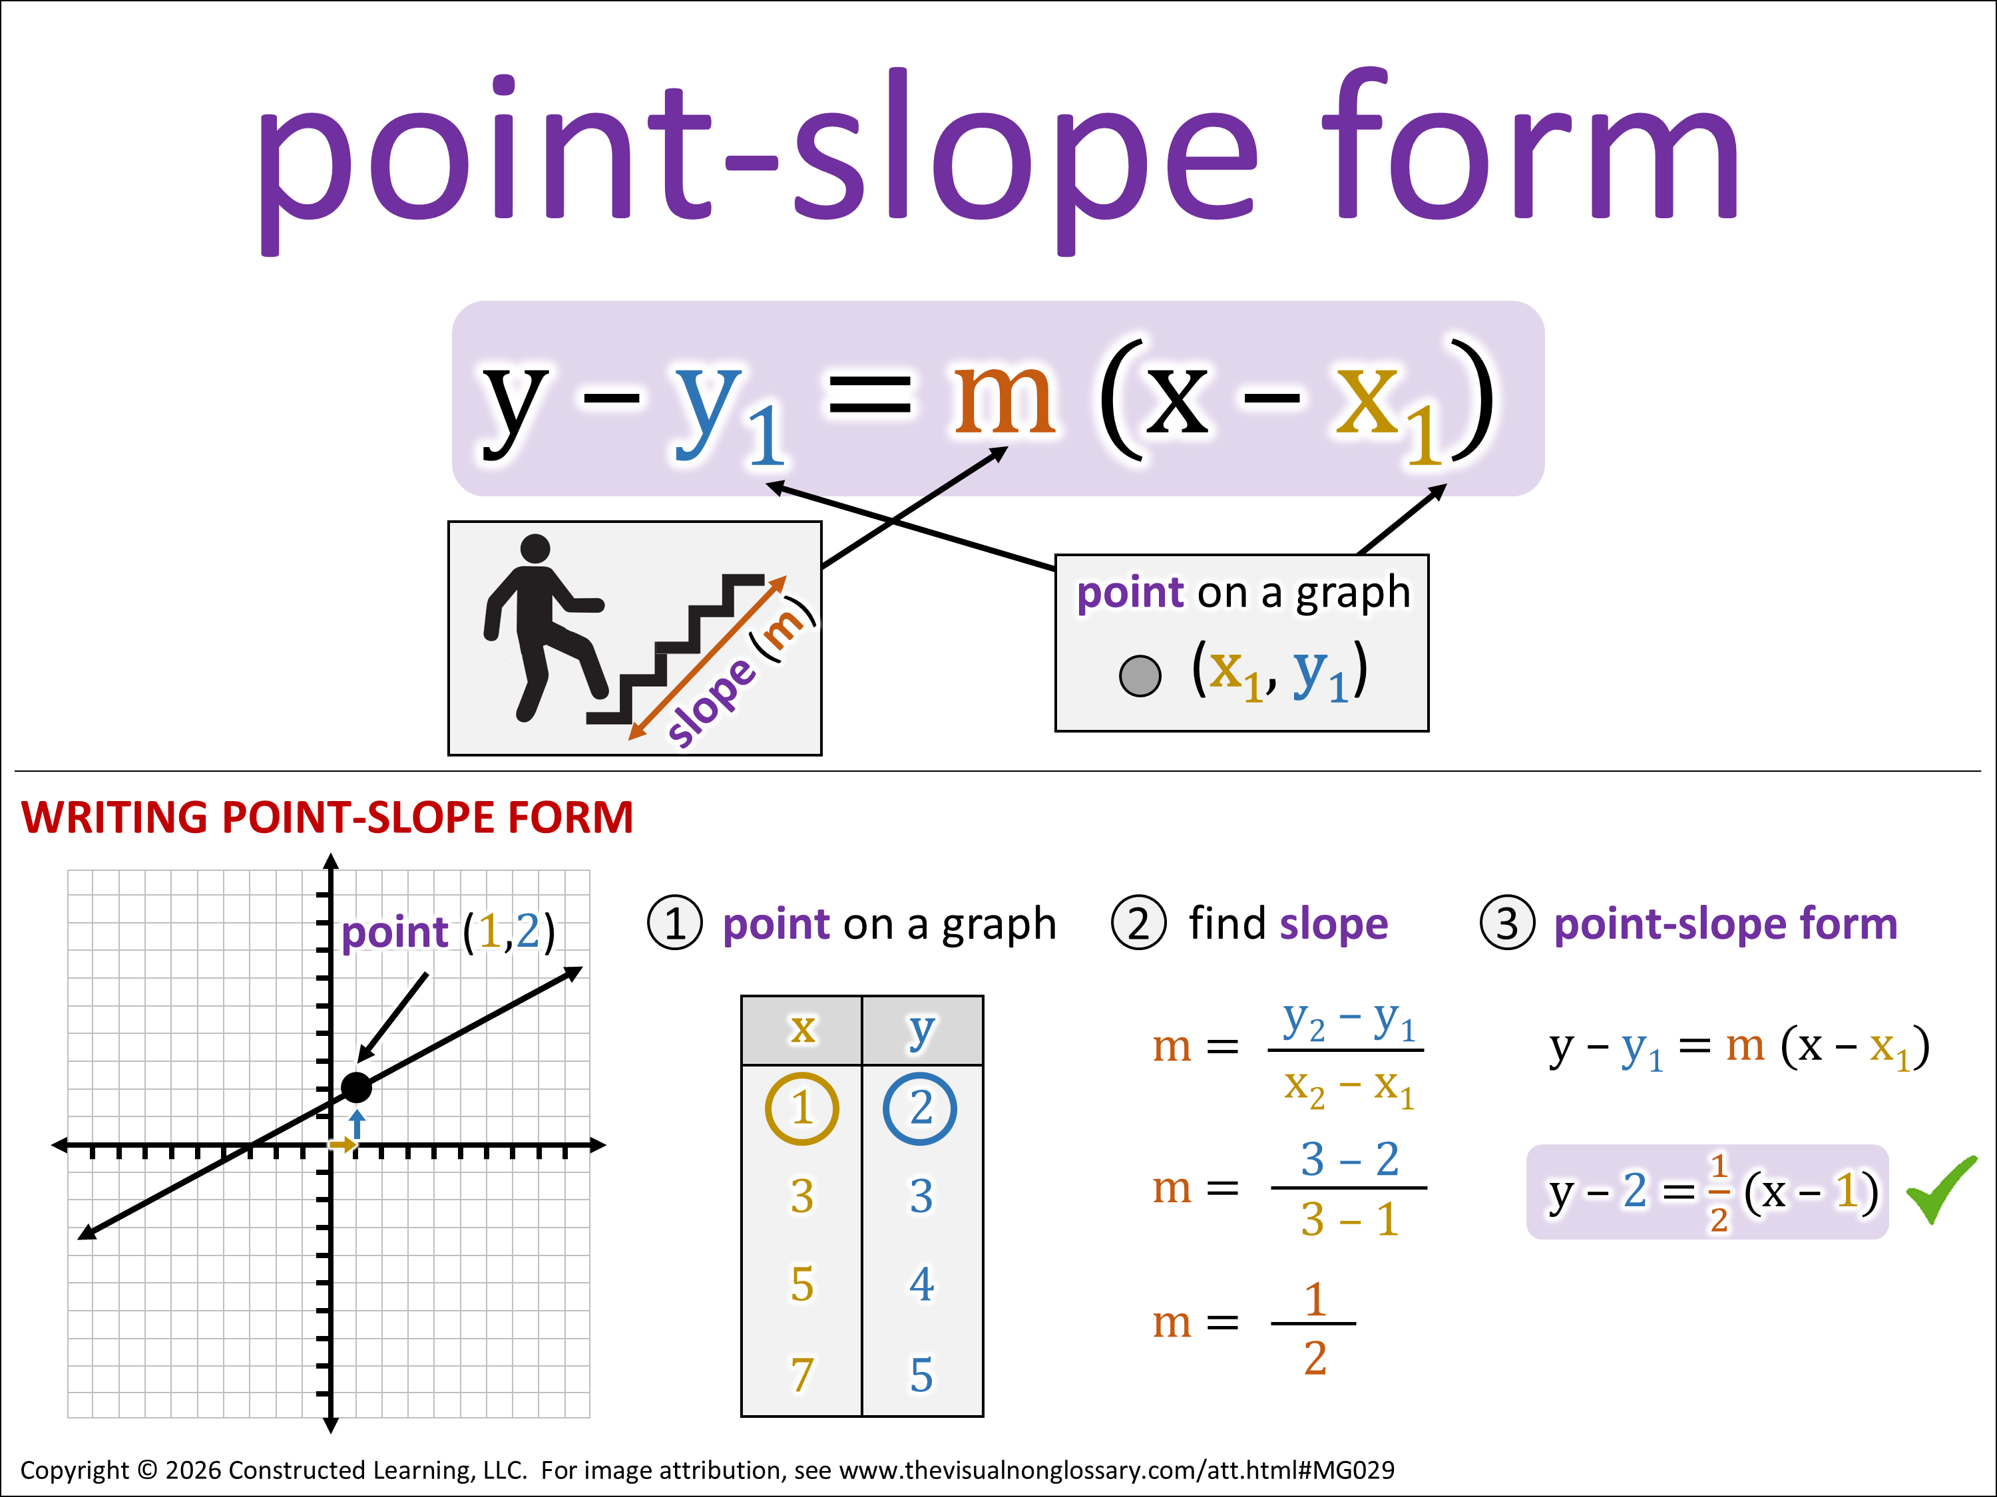
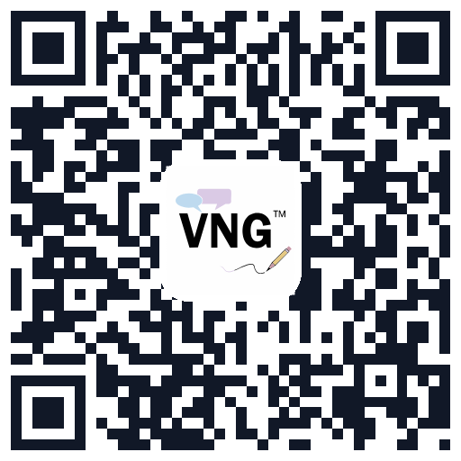

Structuring Conversations
This may sound like...
Class, let’s pronounce this word out loud: (read point-slope form out loud slowly).
Can everybody _______ (signal)? Think about this question. When you are ready to finish this sentence, _______ (stem), show me by _______ (undo the signal).
You are going to share with _______ (share). The person in your group that will go first is _______.
I’m going to _______ (assess). It’s okay if you say what you said or what your partner said, as long as you use ________ (vocabulary word) in a complete sentence. I recommend you use the sentence stem, ________ (stem).
What is the point-slope form?
Point-slope form is…
Reminder!
This lesson should only be used by teachers who have an active VNG license.
What does this look like?
Notes:
For the teacher, not to be displayed to students.

Slide 3







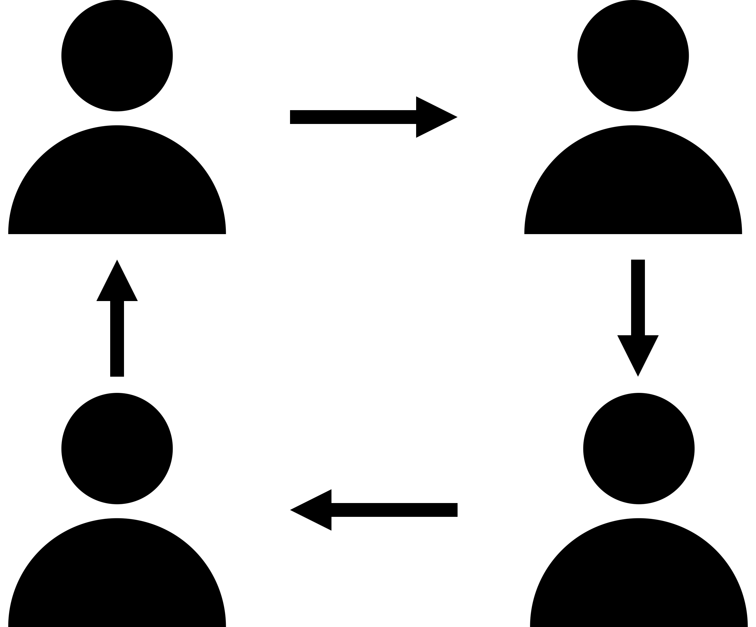







Guide to Icons
Signal:
Assess:
raise your thumb, lower when ready
stand up, sit down when ready
raise your hand, lower when ready
hand on head, lower when ready
using a randomization system
one student from each group
all students write response
Share:
Goes 1ˢᵗ:
A
with shoulder partner or away partner
lightest shoe
darkest shoe
brightest shirt
darkest shirt
Student A/B/C/D (editable)
closest to door
closest to window
with table group
Notes:
For the teacher, not to be displayed to students.

Slide 4








Accommodations for Newcomers or Beginner Emergent Bilingual Students
Seat beginners next to students who follow instruction well, so they can model behavior during the structured conversations.
If sentence stems are complex,
encourage beginners to use these alternative stems:
Observational:
I notice… or [word] is…
Relational:
[word #1] is…, but [word #2] is…
Inferential:
I think [word]… or I predict [word]…
Have students echo new vocabulary words after you, pronouncing them together as a class. It’s even more effective for beginners if you break up each syllable while pointing to your mouth.
Have beginners participate in structured conversations, but make sure they’re ready before including them in the randomization pool to be called on whole-class.
Allow students to translanguage, or use multiple languages within a single sentence. Emphasize that they use the vocabulary word as it is presented, but otherwise encourage beginners to express themselves however they’re most comfortable.
Share the visuals and sentence stems with beginners the day before and have them write out their responses ahead of time.
Does your beginner read in Spanish? Try providing the Spanish visuals to your newcomer the day before.
Notes:
For the teacher, not to be displayed to students.
For a modelled example of supporting students to prepare them for randomization, see 7 Steps to a Language-Rich Interactive Classroom by John Seidlitz & Bill Perryman (p.17-18).

Slide 5



Warm-Up
5 things you notice in this image.
I notice…
1 thing you wonder about in this image.
I wonder…
Notes:
This can be done independently, with a partner, or students can create individual lists and then share with a partner.
We recommend having students share whole-group and then extending what they noticed and wondered using questions like this:
• So you're saying...
• Did anybody else notice...?
• I also noticed that. Why do you think that...?
• I didn't hear anyone mention... did anyone notice...?
• So you were wondering about...
• Why were you wondering that?
• That's interesting because...
• Did anyone wonder about...

Slide 6
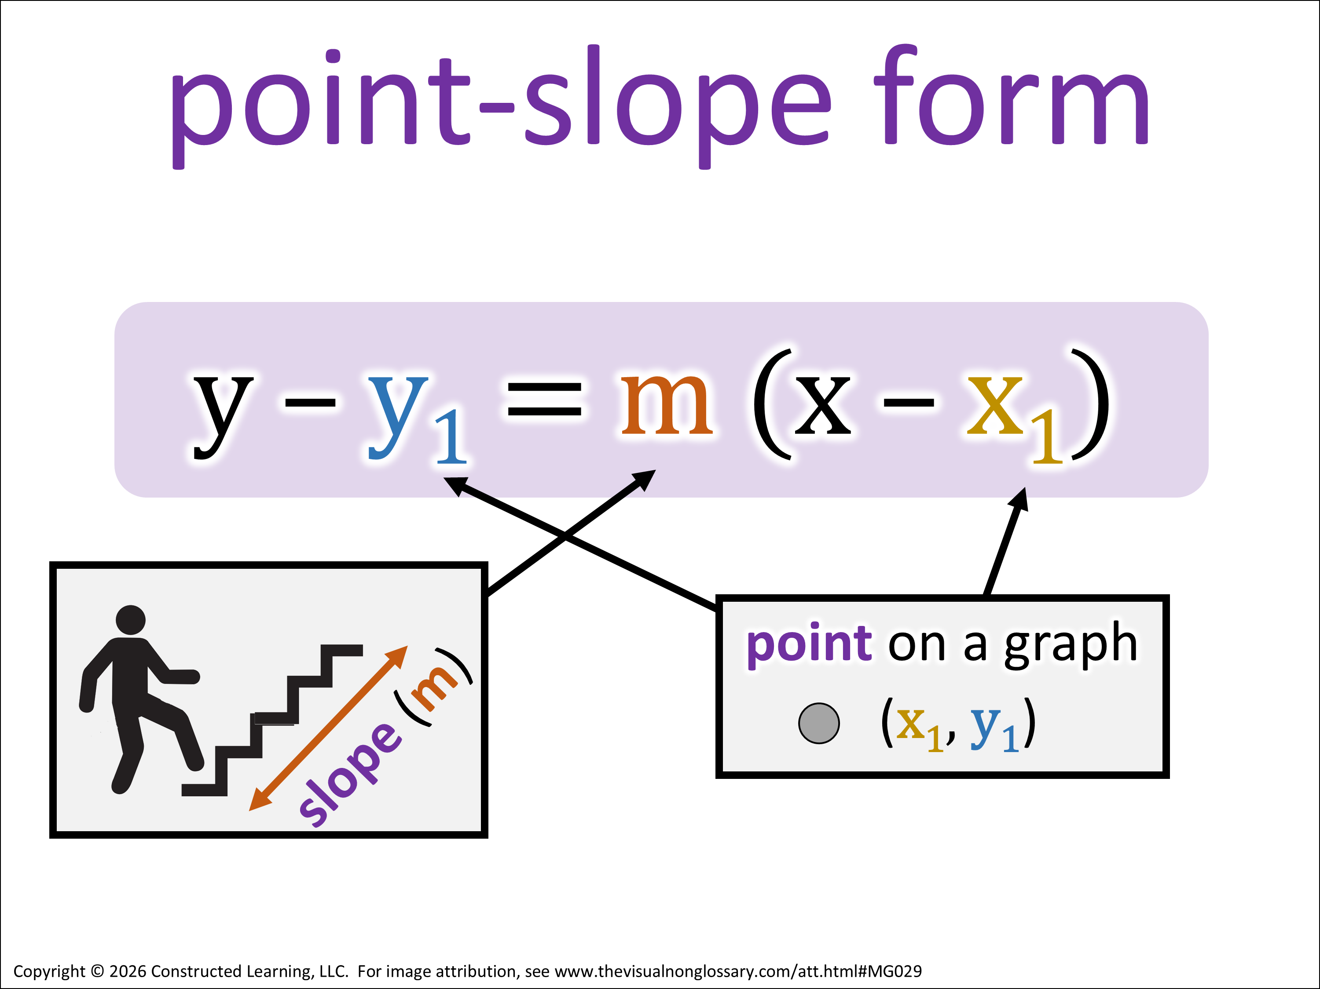
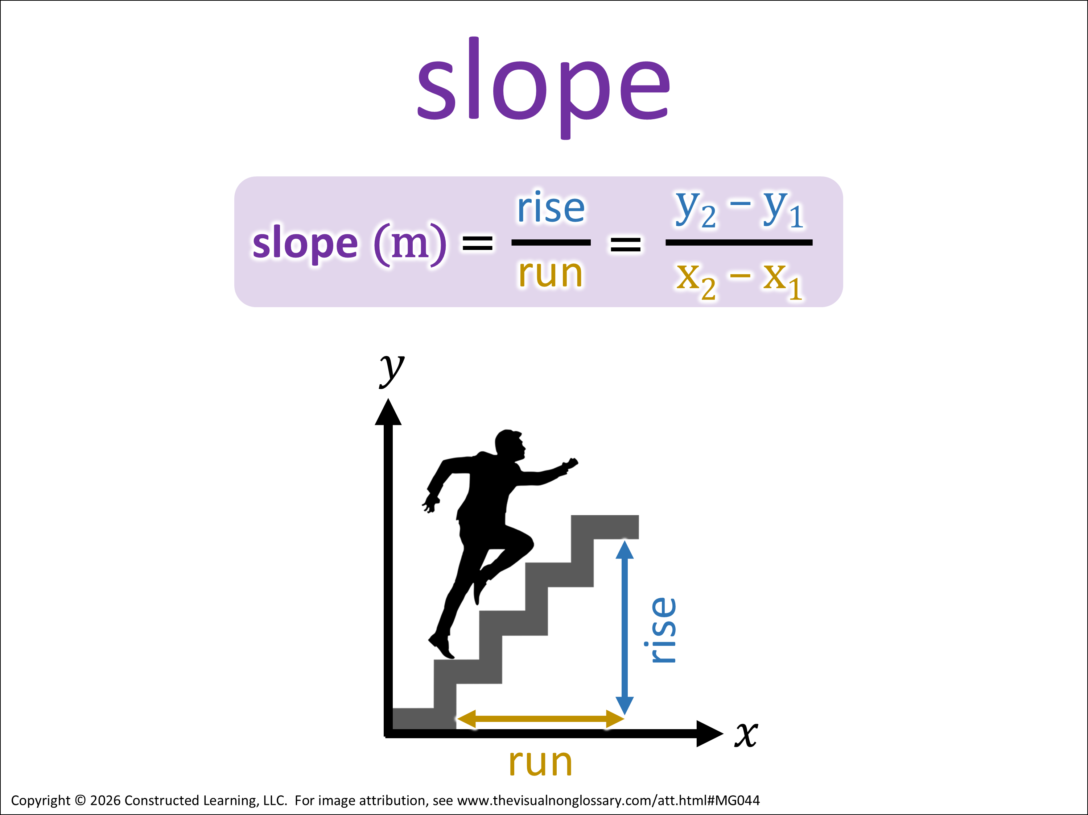


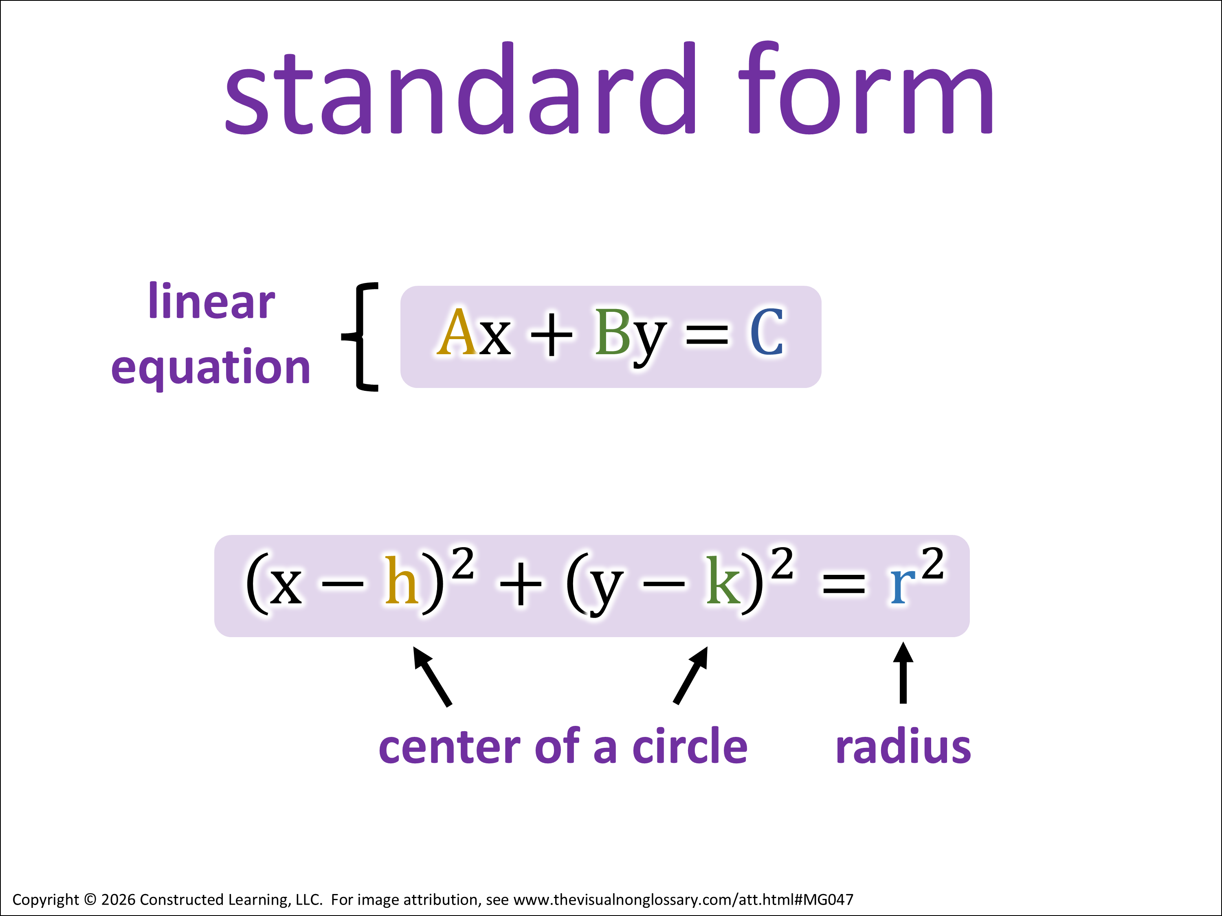


Objectives Conversation
Based on the language objective and the images,
complete one of these:
I think the question is asking...
I think that the term _____ means... because...
The picture makes me think of... because...
Today’s Focus: point-slope form
Content Objective
Today we will talk about point-slope form.
Language Objective
In complete sentences, I can answer this question using the vocabulary words to the right:
Signal:
When might you use point-slope form instead of standard form? Why?
Share:
I might use point-slope form instead of standard form when… because…
Goes 1ˢᵗ:
A
Assess:
Notes:
It is recommended that the language objective is writing (for Grades 2-12) with speaking occurring during structured conversations throughout the lesson.
The content objective can be edited to use the specific verbiage of the learning standard.
Note: There are several different styles of writing objectives, and please adjust these objectives to meet the norms of your campus or district. Our approach is to make objectives simple so that energy can be focused on the student interaction with the objectives.
This activity is called Gearing Up for the Guiding Question and is described in more detail in Teaching Science to English Learners by Stephen Fleenor and Tina Beene (p.24-25).

Slide 7
Observational Question
What is the point-slope form?
Point-slope form is…
Signal:
Share:
Goes 1ˢᵗ:
A
Assess:
Notes:
Structured Conversation
Script:
Class, let’s pronounce this word out loud: (read out vocabulary word)
Can everybody _______ (signal). Think about this question. When you are ready to finish this sentence, _______ (stem), show me by _______ (undo the signal).
You are going to share with _______ (share). The person that will go first is _______ (share).
I’m going to _______ (assess). It’s okay if you say what you said or what your partner said, as long as you use ________ (vocabulary word) in a complete sentence. I recommend you use the sentence stem, ________ (stem).

Slide 8
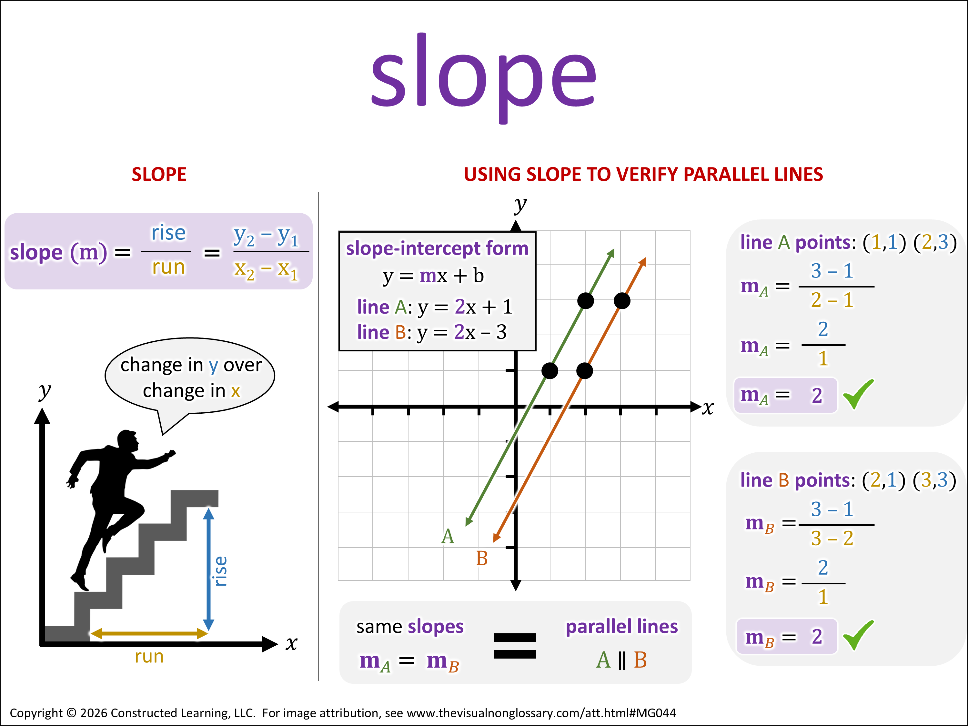
Observational Question
What is slope?
Slope is…
Signal:
Share:
Goes 1ˢᵗ:
A
Assess:
Notes:
Structured Conversation
Script:
Class, let’s pronounce this word out loud: (read out vocabulary word)
Can everybody _______ (signal). Think about this question. When you are ready to finish this sentence, _______ (stem), show me by _______ (undo the signal).
You are going to share with _______ (share). The person that will go first is _______ (share).
I’m going to _______ (assess). It’s okay if you say what you said or what your partner said, as long as you use ________ (vocabulary word) in a complete sentence. I recommend you use the sentence stem, ________ (stem).

Slide 9



Relational Question
How is the point-slope form related to slope?
Point-slope form is related to slope because…
Signal:
Share:
Goes 1ˢᵗ:
A
Assess:
Notes:
Structured Conversation
Delete or hide this slide if the relational question does not refer to two vocabulary words which each have a visual.
Script:
Can everybody _______ (signal). Think about this question. When you are ready to finish this sentence, _______ (stem), show me by _______ (undo the signal).
You are going to share with _______ (share). The person that will go first is _______ (share).
I’m going to _______ (assess). It’s okay if you say what you said or what your partner said, as long as you use ________ (vocabulary word) in a complete sentence. I recommend you use the sentence stem, ________ (stem).

Slide 10
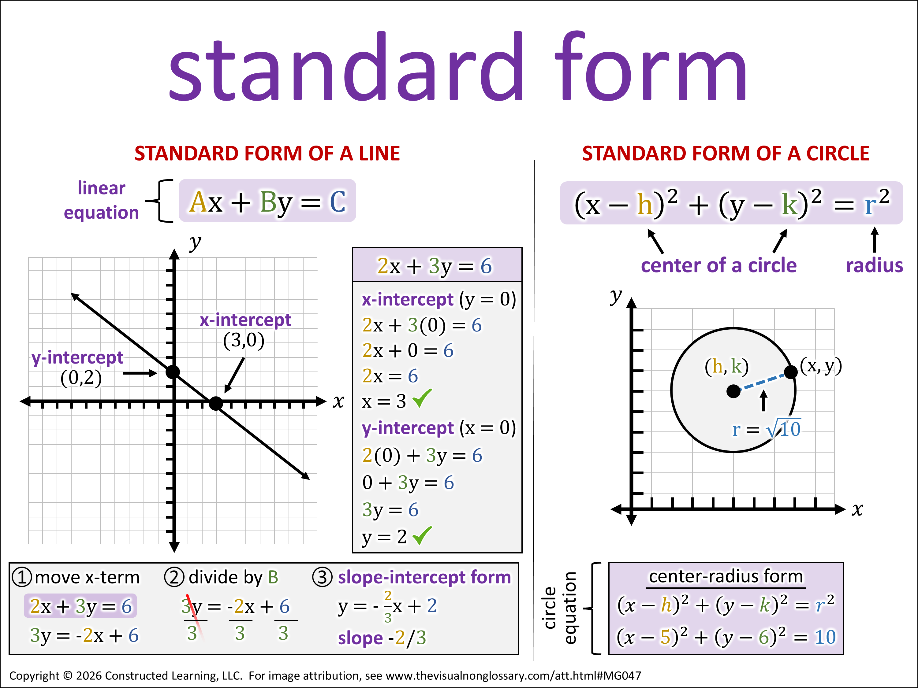
Observational Question
What is standard form?
Standard form is…
Signal:
Share:
Goes 1ˢᵗ:
A
Assess:
Notes:
Structured Conversation
Script:
Class, let’s pronounce this word out loud: (read out vocabulary word)
Can everybody _______ (signal). Think about this question. When you are ready to finish this sentence, _______ (stem), show me by _______ (undo the signal).
You are going to share with _______ (share). The person that will go first is _______ (share).
I’m going to _______ (assess). It’s okay if you say what you said or what your partner said, as long as you use ________ (vocabulary word) in a complete sentence. I recommend you use the sentence stem, ________ (stem).

Slide 11




Inferential Question
When might you use point-slope form instead of standard form? Why?
I might use point-slope form instead of standard form when… because…
Signal:
Share:
Goes 1ˢᵗ:
A
Assess:
Notes:
Structured Conversation
Recommended: use this or the final extension activity (Open Writing) as a closure or exit ticket. Have students discuss their answers in groups, then write their answers.
Script:
Can everybody _______ (signal). Think about this question. When you are ready to finish this sentence, _______ (stem), show me by _______ (undo the signal).
You are going to share with _______ (share). The person that will go first is _______ (share).
I’m going to _______ (assess). It’s okay if you say what you said or what your partner said, as long as you use ________ (vocabulary word) in a complete sentence. I recommend you use the sentence stem, ________ (stem).

Slide 12
Extension Activities​
Use any or all of the activities in the following slides between structured conversations or after students have completed all of the structured conversations.
• Draw and Write
Have students draw the vocabulary word and label it with key lesson terms, then write about how it connects to their understanding of the word.
• Complete the Picture
Do this before showing the complete visual for a prediction activity, or after showing the visual for a recall exercise.
• Fill It In
Like “Complete the Picture”, this activity is also excellent as either a preview or a review.
• Evidence-Claim-Reasoning
Have students create a question, then answer it with a claim and evidence-based reasoning.
• Vocab Connection Web
Have students make connections to other words in this unit, or other words in previous units. Excellent as a unit review!
• Roving Paragraph
Get students moving, and writing! Can be done at any point in the lesson, but it makes an excellent review at the end of the lesson.
• Open Writing
This is highly recommended after the structured conversations are complete, as an alternative closure/exit ticket to the lesson. Have students write everything they’ve learned about the vocabulary word, structured with the sentence stems of their structured conversations and key vocabulary.
Jump to this slide
Jump to this slide
Jump to this slide
Jump to this slide
Jump to this slide
Jump to this slide
Jump to this slide
Notes:
For the teacher, not to be displayed to students.

Slide 13

Draw and Write
point-slope form
Draw a representation for the term point-slope form. Label your visual with the terms:
•
•
•
•
•
Notes:
It is recommended that this activity is done as a review after the students have been exposed to some understanding of the word. This activity can be done independently or in groups.

Slide 14
Draw and Write
point-slope form
Explain how your visual relates to what you’ve learned about point-slope form
• My visual is…
• It relates to what I’ve learned about point-slope form because...
Notes:
It is recommended that this activity is done as a review after the students have been exposed to some understanding of the word. This activity can be done independently or in groups.

Slide 15

Complete the Picture
Draw what you think the rest of the image looks like for the term point-slope form.
Notes:
It is recommended that this activity is done as a warm-up before being introduced to the word, or as a review at the end of the lesson. This activity can be done independently or in groups.
This activity is called Complete the Picture and is described in more detail in Teaching Science to English Learners by Stephen Fleenor and Tina Beene (p.30).

Slide 16
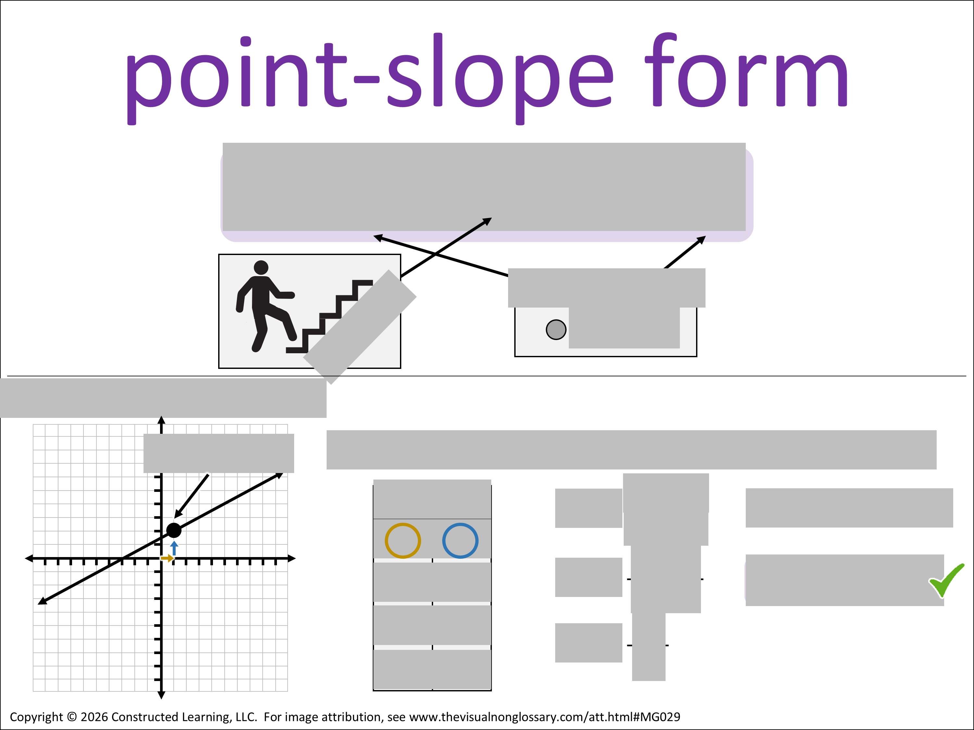
Fill It In
Fill in the grey boxes in this visual as best you can.
Work with a partner or share your completed visual with a partner when you finish.
Notes:
It is recommended that this activity is done as a prediction warm-up before being introduced to the word, or as a review at the end of the lesson. This activity can be done independently or in groups.

Slide 17




Evidence-Claim-Reasoning
Choose a question:
One thing I don't know is...
One thing I wonder is...
I did not understand when we talked about ______.
Signal:
Share:
Goes 1ˢᵗ:
A
Assess:
Notes:
The first part of this activity is taken from Questioning Conversation, described in Teaching Science to English Learners by Stephen Fleenor and Tina Beene (p.31).
Instead of students selecting a question, the teacher can select a question and skip to the next slide.

Slide 18
Evidence-Claim-Reasoning
Question:
When might you use point-slope form instead of standard form? Why?
Provide Evidence:
I see that...
I know that...
I read that...
Signal:
Share:
Goes 1ˢᵗ:
A
Assess:
Notes:
This activity is sometimes presented as Claim-Evidence-Reasoning. In our experience, having students first assemble evidence relevant to the question can help to craft a claim with evidence-based reasoning. This process is described in more detail on pages 49-50 of Teaching Science to English Learners by Stephen Fleenor and Tina Beene.
On this slide, simply ask students to list any evidence related to the question. Instruct them to not try to answer the question just yet. The first sentence stem can be used to draw evidence from the visual, and the other sentence stems can be used to draw evidence from elsewhere in the lesson or their daily lives. This activity works very well when students create a list as a small group.
The question can be teacher-generated or student-generated. By default, we've put the inferential question in here and the stem on the following slide.
If you would like to select an explanation-based question, use an open-ended question that contains the verbs How, Why, Describe, or Explain.
If you would like to select an argument-based question, you can use one of the question stems below:
Closed-ended with choices
• Which is the most...
• Which is the least...
• Which is the best...
• Which is the worst...
• Which is the most important...
Open-ended with predictions or evaluations
• What would occur if...
• If this changes, how does that affect...
• What is the impact on...
• Is this necessary for...
• Do you agree with the claim...

Slide 19
Evidence-Claim-Reasoning
Question:
When might you use point-slope form instead of standard form? Why?
Claim
I might use point-slope form instead of standard form when… because…
Signal:
Share:
Goes 1ˢᵗ:
A
Assess:
Notes:
This activity is sometimes presented as Claim-Evidence-Reasoning. In our experience, having students first assemble evidence relevant to the question can help to craft a claim with evidence-based reasoning. This process is described in more detail on pages 49-50 of Teaching Science to English Learners by Stephen Fleenor and Tina Beene.
On this slide, have your students write a single sentence answering the question (without evidence). This should be done independently. If "because..." is at the end of the sentence stem, we recommend removing it. They will justify their reasoning on the next slide.

Slide 20
Evidence-Claim-Reasoning
Question:
When might you use point-slope form instead of standard form? Why?
Make a Claim with Reasoning:
Based on the fact that
_______, I infer that...
because...
_______ means that...
because...
I see _______. This supports
my claim that... because...
Signal:
Share:
Goes 1ˢᵗ:
A
Assess:
Notes:
This activity is sometimes presented as Claim-Evidence-Reasoning. In our experience, having students first assemble evidence relevant to the question can help to craft a claim with evidence-based reasoning. This process is described in more detail on pages 49-50 of Teaching Science to English Learners by Stephen Fleenor and Tina Beene.
Have the students share one of the sentence stems with their partner or group, and then add a sentence in writing to their claim.

Slide 21
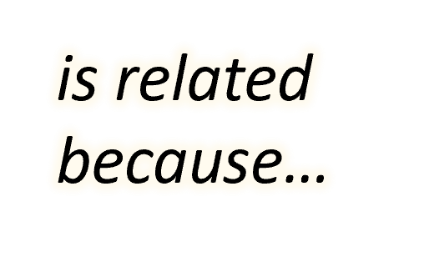
Vocab Connection Web
Make a word map connecting point-slope form to 3-5 other vocabulary words.
Next to each connecting line, describe how the two words are related.
Work with a partner or share your word map with a partner when you finish.
Notes:
For example, if the central word is “atom”, a student might:
Make a connection to “proton” and write “atoms contain protons” next to the connecting line.
Make a connection to “molecule” and write “atoms make up molecules” next to the connecting line.
Make a connection to “matter” and write “atoms are the smallest units of matter” next to the connecting line.
Make a connection to “nucleus” and write “the center of an atom is the nucleus” next to the connecting line.
Alternatively, students can create a custom Vocab Connection Web (Teaching Science to English Learners by Fleenor and Beene, 2019, p.53) in which any connection can be made between any two words – there does not have a to a “central” word.

Slide 22
Roving Paragraph​
Write a sentence using either sentence stem:
The term point-slope form...
From this visual, I can infer… (use point-slope form in your response)
Notes:
This activity is especially recommended for encouraging movement and building confidence with literacy.
This activity is called Roving Paragraph and is described in more detail in 7 Steps to a Language-Rich, Interactive Classroom (2nd Ed) by John Seidlitz & Bill Perryman (p.151).

Slide 23
Roving Paragraph​
Find another student and add their sentence to yours, using a transition word:​
• Also, …
• Additionally, …
• Furthermore, …
• Next, …
• For example, …
• Lastly, …
• Therefore, …
Repeat 2 to 4 times.
Notes:
This activity is especially recommended for encouraging movement and building confidence with literacy.
This activity is called Roving Paragraph and is described in more detail in 7 Steps to a Language-Rich, Interactive Classroom (2nd Ed) by John Seidlitz & Bill Perryman (p.151).

Slide 24
Writing
Write a paragraph describing the term point-slope form. Include 3-5 other vocabulary words in your paragraph. You may include the following stems:
Point-slope form is…
Point-slope form is related to slope because…
I might use point-slope form instead of standard form when… because…
Notes:
When students are finished, it is recommended that they share their paragraphs with a partner or group, with time afterwards to make any edits to their paragraphs.

Slide 25

Notes:
Print this slide out and display it on your word wall, or use this image to as a simplified scaffold in structured conversations.

Slide 26
Notes:
Print this slide out and display it on your word wall, or use this image to as a simplified scaffold in structured conversations.

Slide 27
Notes:
Print this slide out and display it on your word wall, or use this image to as a simplified scaffold in structured conversations.

