Slide 1
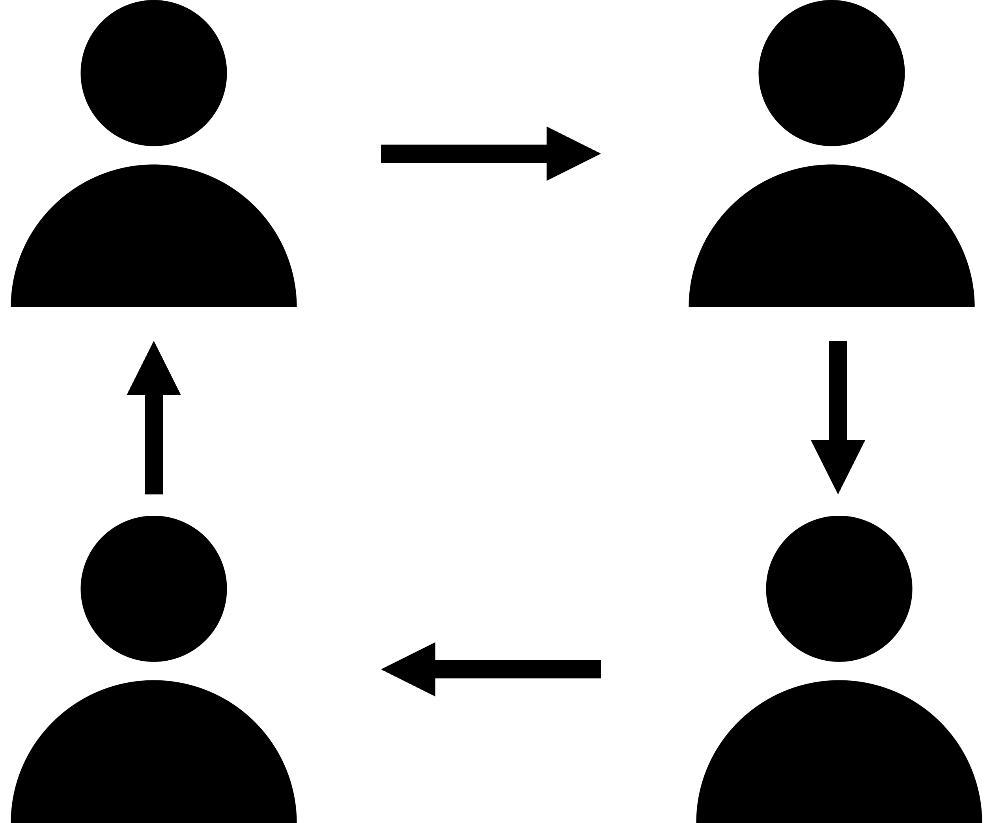
Observational Question
VISUAL GOES HERE
Question goes here
Sentence stem goes here…
Signal:
Share:
Goes 1ˢᵗ:
A
Assess:
Notes:
Script:
Class, let’s pronounce this word out loud: (read vocabulary word out loud slowly).
Can everyone (raise a thumb/stand up/raise your hand/put your hand on your head)? Think about this question, when you are ready to answer this question, (lower your hand/sit down).
You are going to share with (shoulder partner/table group/away partner). The person in your group that will go first is the person (with the longest hair/with the shortest hair/with the brightest shirt/with the darkest shirt/[letter designation within the table group]/closest to the door/closest to the window).
[Students share with their partners/groups. When ~50% of the class is no longer discussing the content, bring everyone back together.]
I’m going to (call on some students randomly/call on one person with each group [perhaps using one of the “Goes 1st” designations]/have everyone write down their response).

