Slide 1
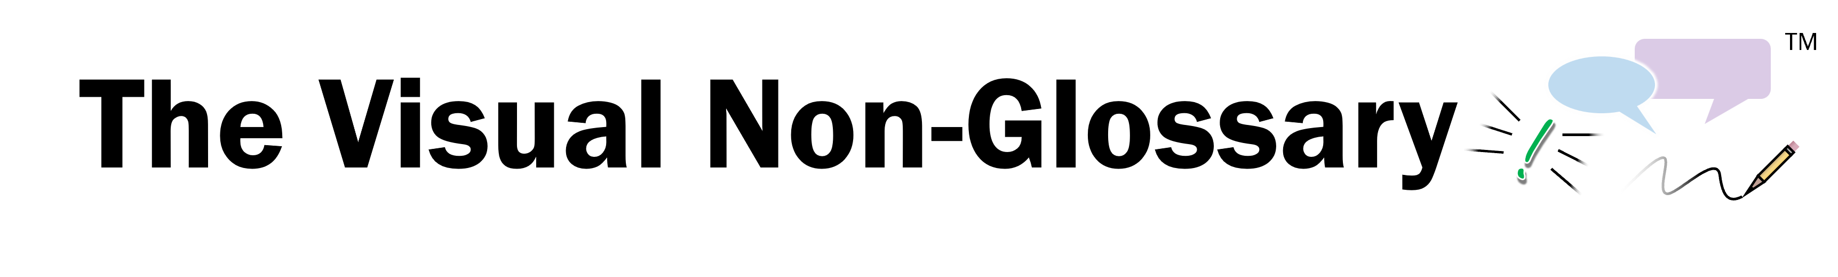









How to Use This QSSSA Practice Guide
Form a group of three or more educators, and have one person play the role of teacher while the rest are students.
The teacher reads out the script using one of the examples in the following slides. Use the icons to complete the script.
Rotate the role of teacher to someone else in the group, and try again using a different example.
In the following slides, there are examples of different grade levels and content areas.
Class, let’s pronounce this word out loud: (read vocabulary word out loud slowly).
Can everybody _______(signal)? Think about this question. When you are ready to finish this sentence, _______(stem), show me by _______ (undo the signal).
You are going to share with _______ (share) The person in your group that will go first is _______ (share).
I’m going to _______ (assess). It’s okay if you say what you said or what your partner said, as long as you use ________ (vocabulary word) in a complete sentence. I recommend you use the sentence stem, ________ (stem).
Signal
“put your thumb up”
“raise your hand”
“put your hand on your head”
“lowering your hand”
Share
“your elbow partner”
“the person closest to the door”
“the person with the darkest shoes”
“the person with the darkest shirt”
Assess
“randomly call on someone”

Slide 2




Science

Slide 3




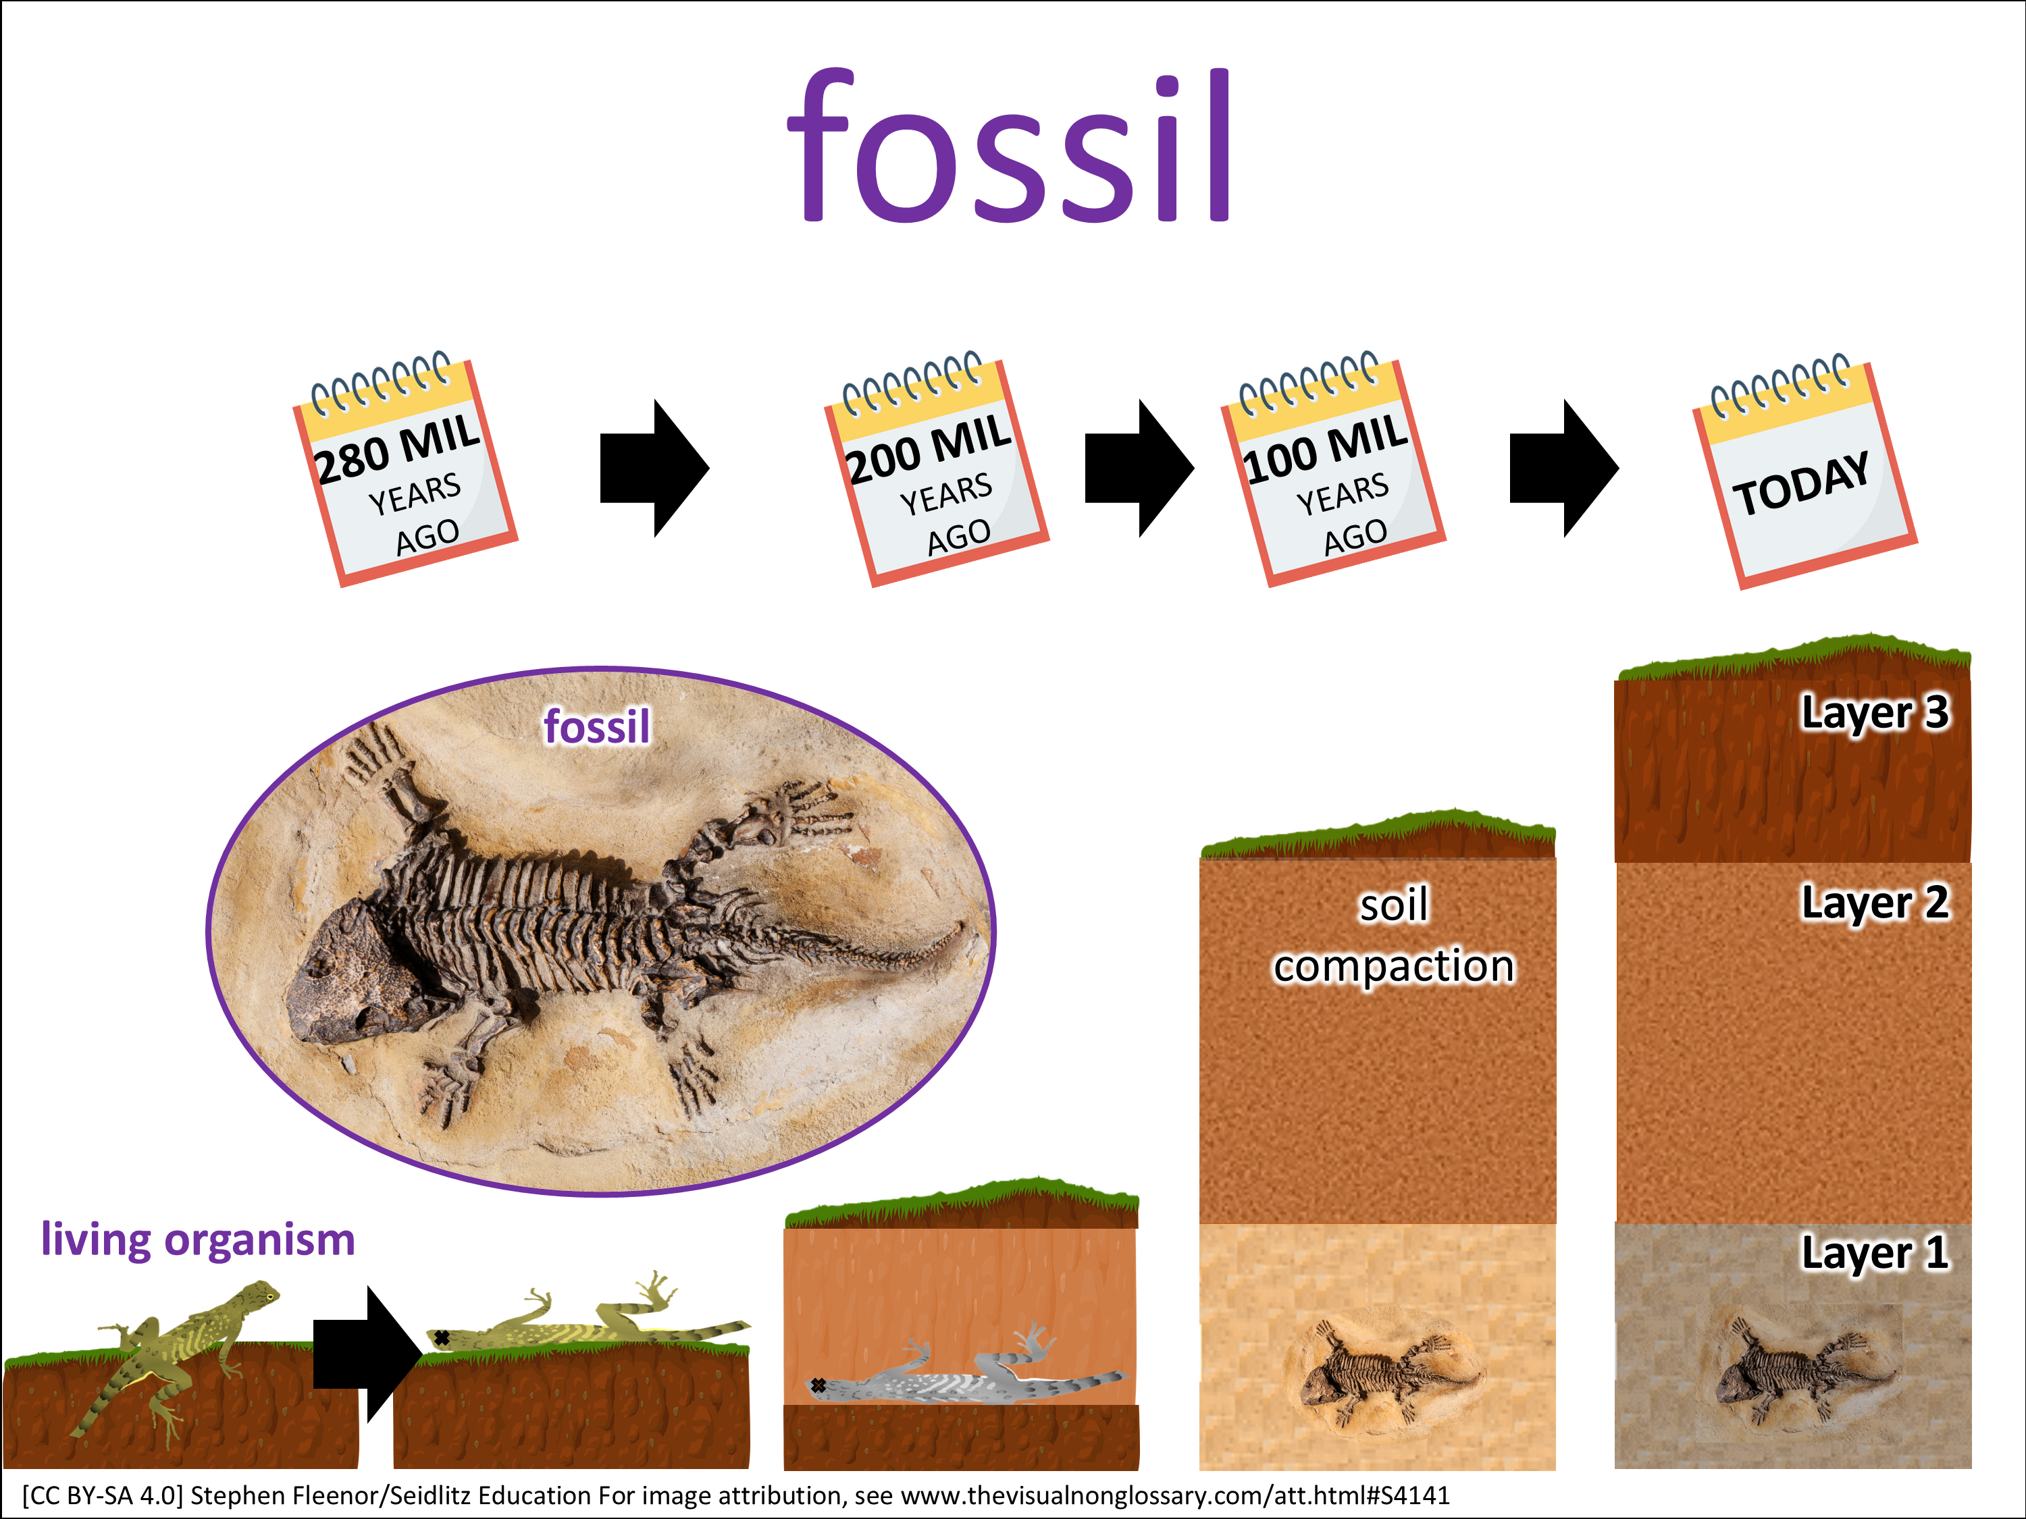

Class, let’s pronounce this word out loud: (read vocabulary word out loud slowly).
Can everybody _______(signal)? Think about this question. When you are ready to finish this sentence, _______(stem), show me by _______ (undo the signal).
You are going to share with _______ (share) The person in your group that will go first is _______ (share).
I’m going to _______ (assess). It’s okay if you say what you said or what your partner said, as long as you use ________ (vocabulary word) in a complete sentence. I recommend you use the sentence stem, ________ (stem).
Question: How do fossils form?
Stem: Fossils form by…
Signal:
Share:
Goes first
Assess:

Slide 4
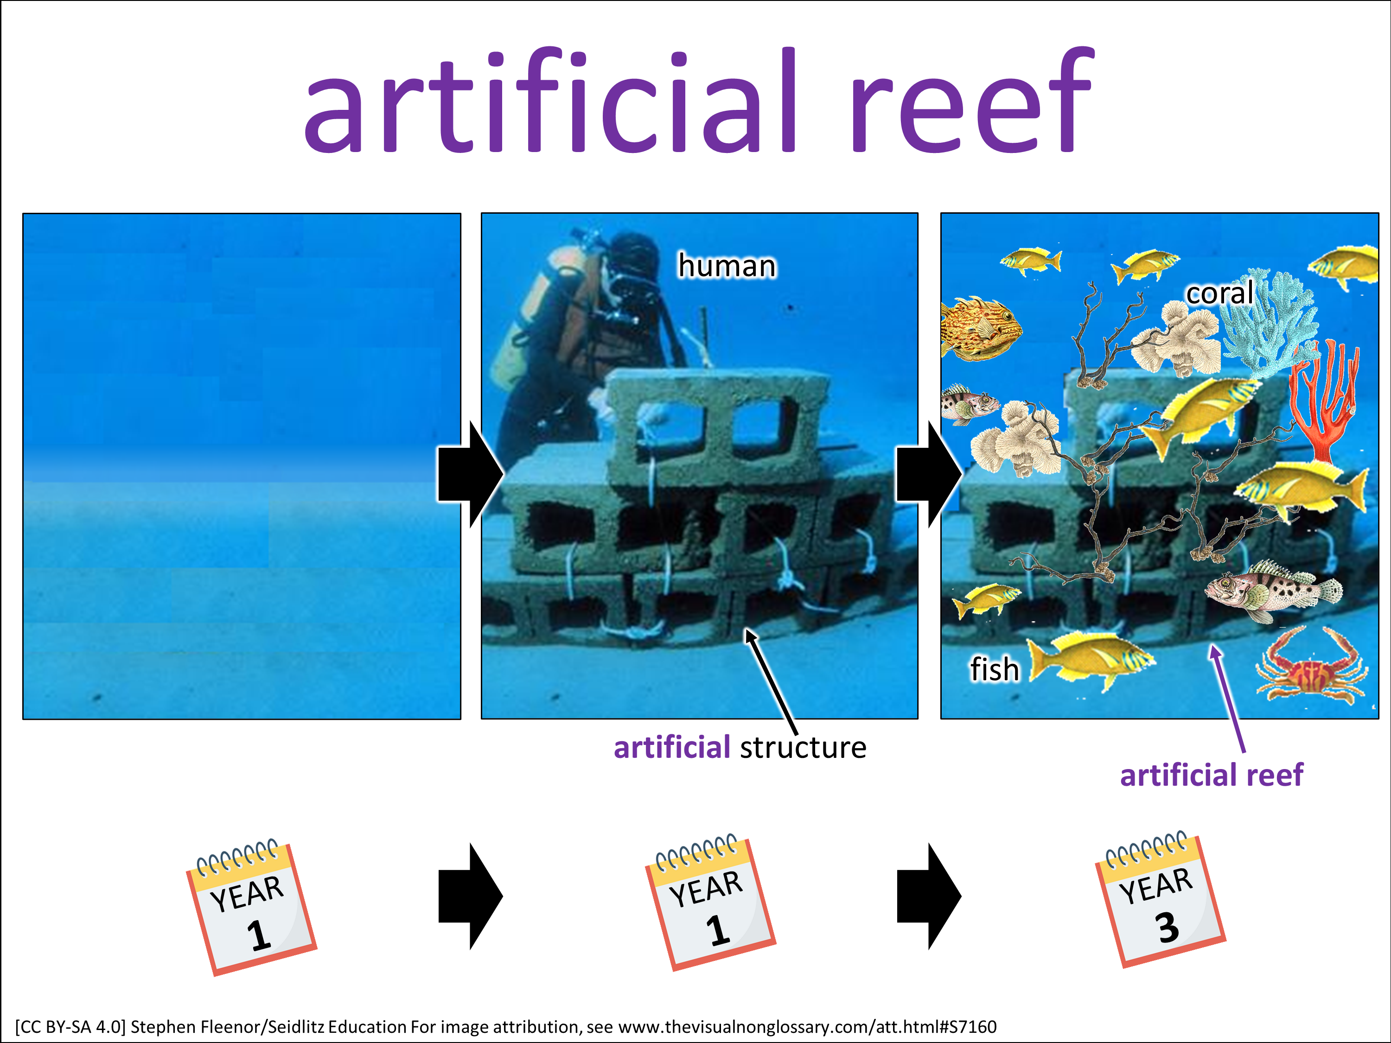
Class, let’s pronounce this word out loud: (read vocabulary word out loud slowly).
Can everybody _______(signal)? Think about this question. When you are ready to finish this sentence, _______(stem), show me by _______ (undo the signal).
You are going to share with _______ (share) The person in your group that will go first is _______ (share).
I’m going to _______ (assess). It’s okay if you say what you said or what your partner said, as long as you use ________ (vocabulary word) in a complete sentence. I recommend you use the sentence stem, ________ (stem).
Question: How is an artificial reef formed?
Stem: An artificial reef is formed by…
Signal:
Share:
Goes first
Assess:

Slide 5
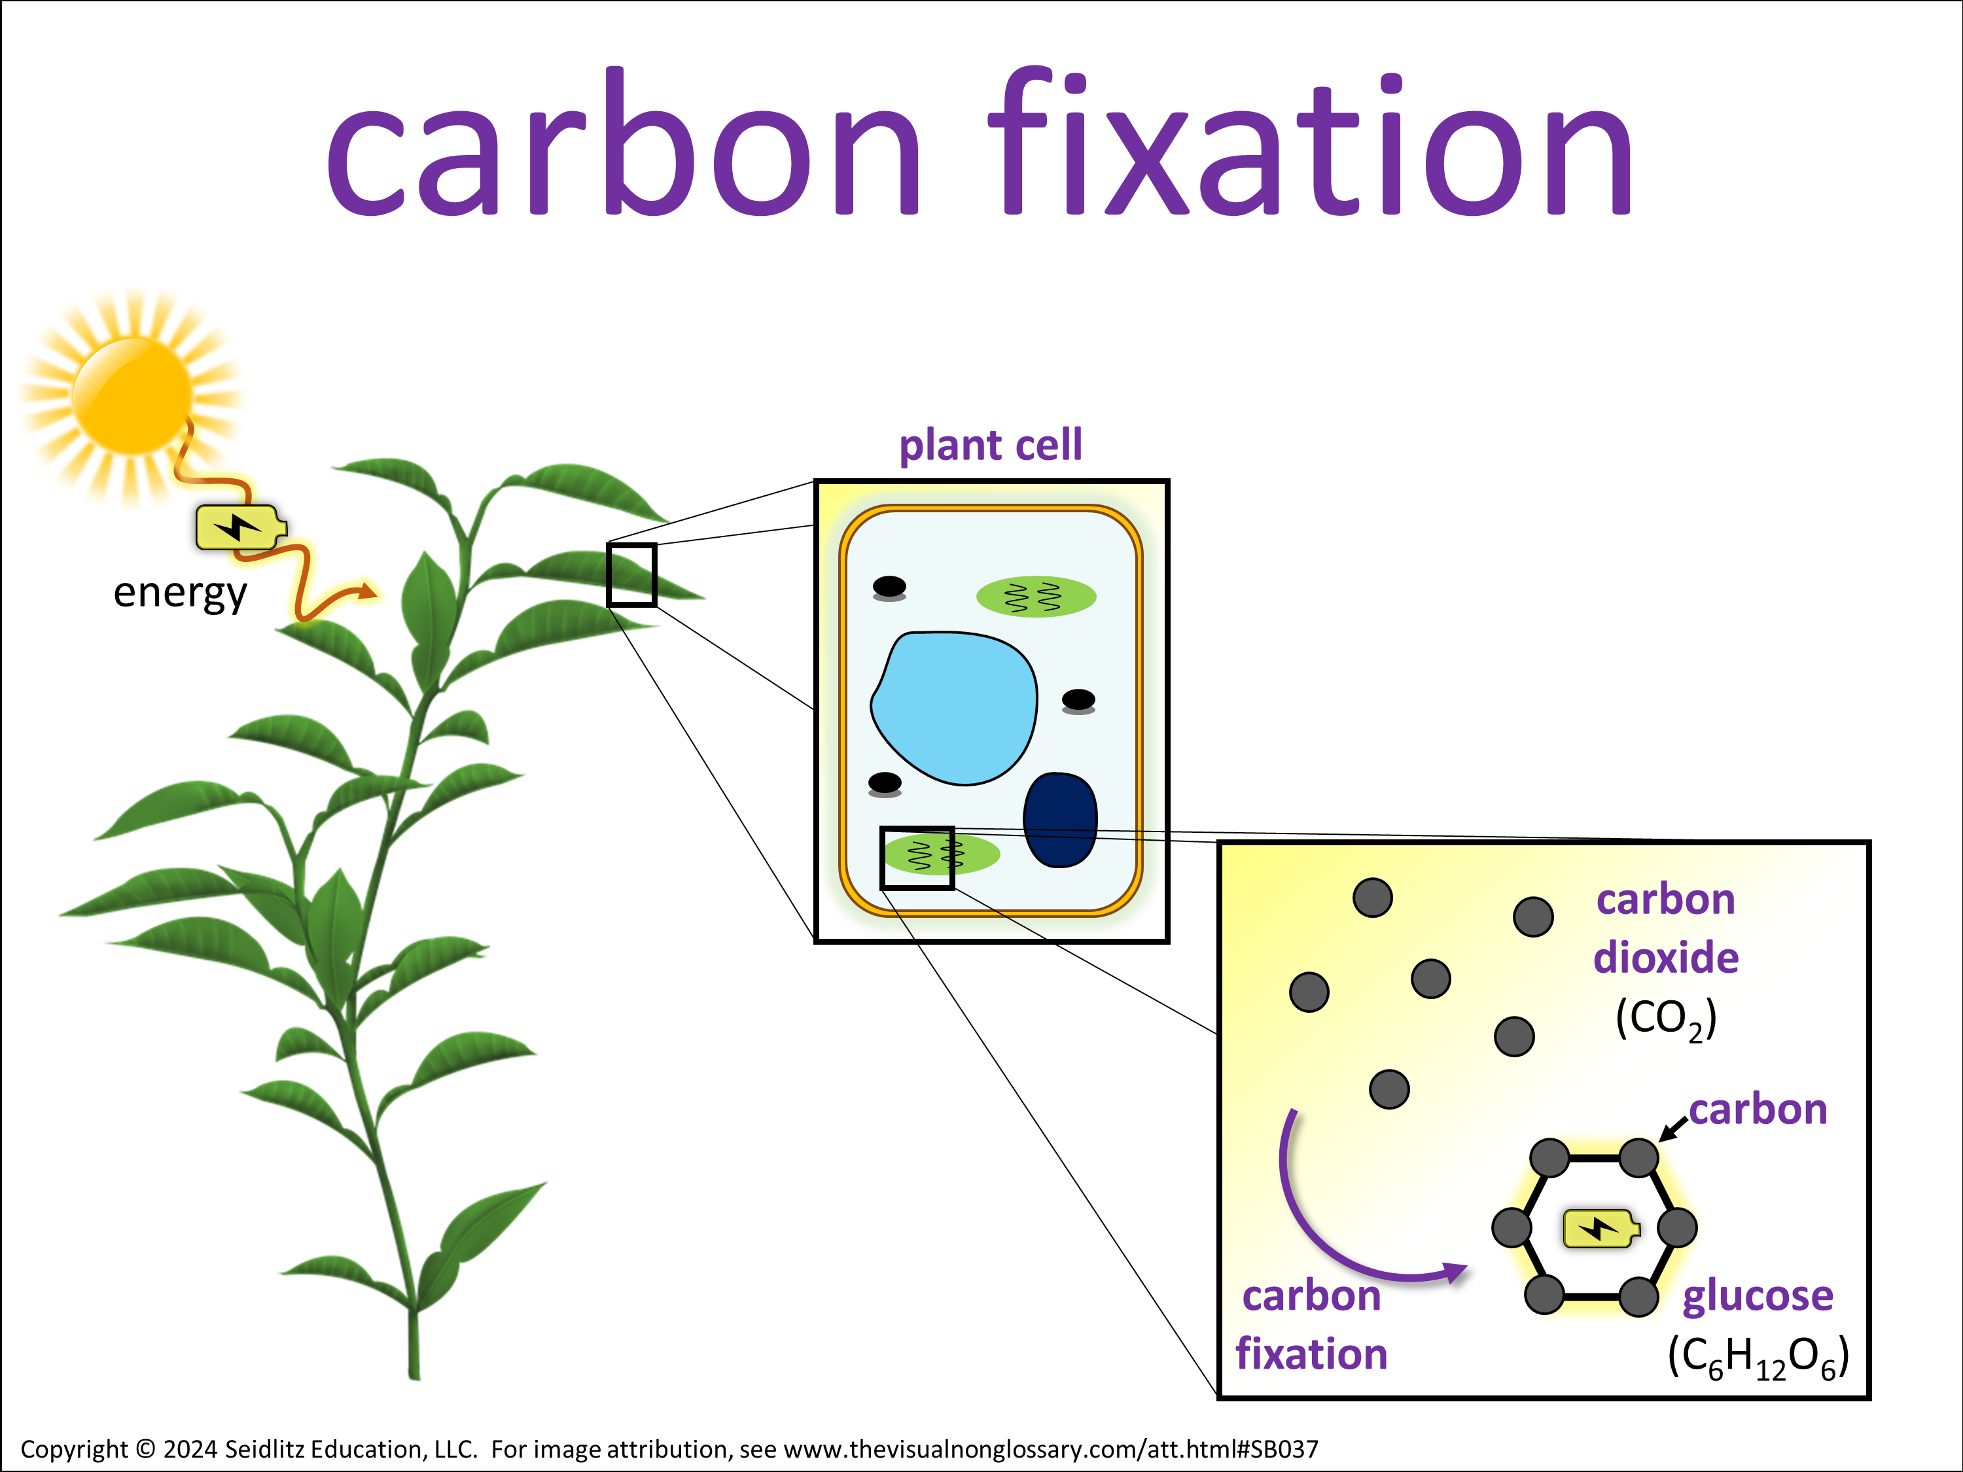
Class, let’s pronounce this word out loud: (read vocabulary word out loud slowly).
Can everybody _______(signal)? Think about this question. When you are ready to finish this sentence, _______(stem), show me by _______ (undo the signal).
You are going to share with _______ (share) The person in your group that will go first is _______ (share).
I’m going to _______ (assess). It’s okay if you say what you said or what your partner said, as long as you use ________ (vocabulary word) in a complete sentence. I recommend you use the sentence stem, ________ (stem).
Question: What occurs during carbon fixation?
Stem: During carbon fixation, …
Signal:
Share:
Goes first
Assess:

Slide 6

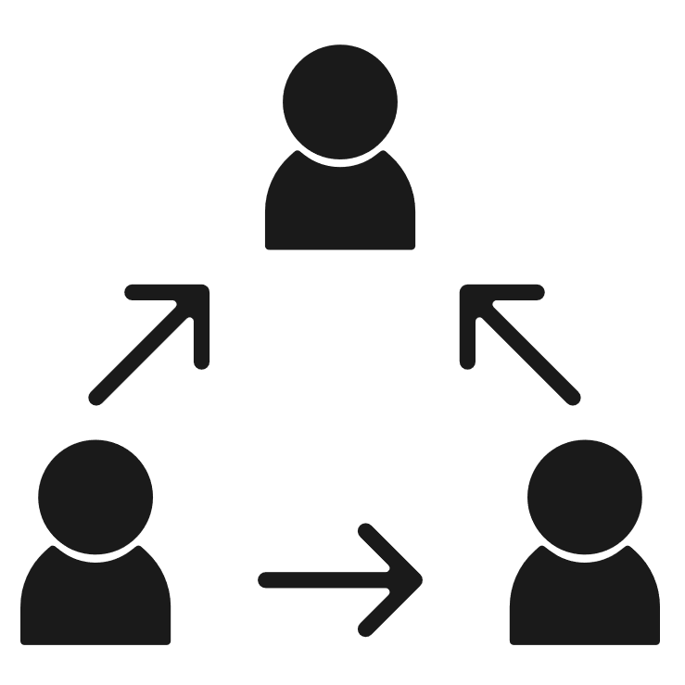


Social Studies

Slide 7
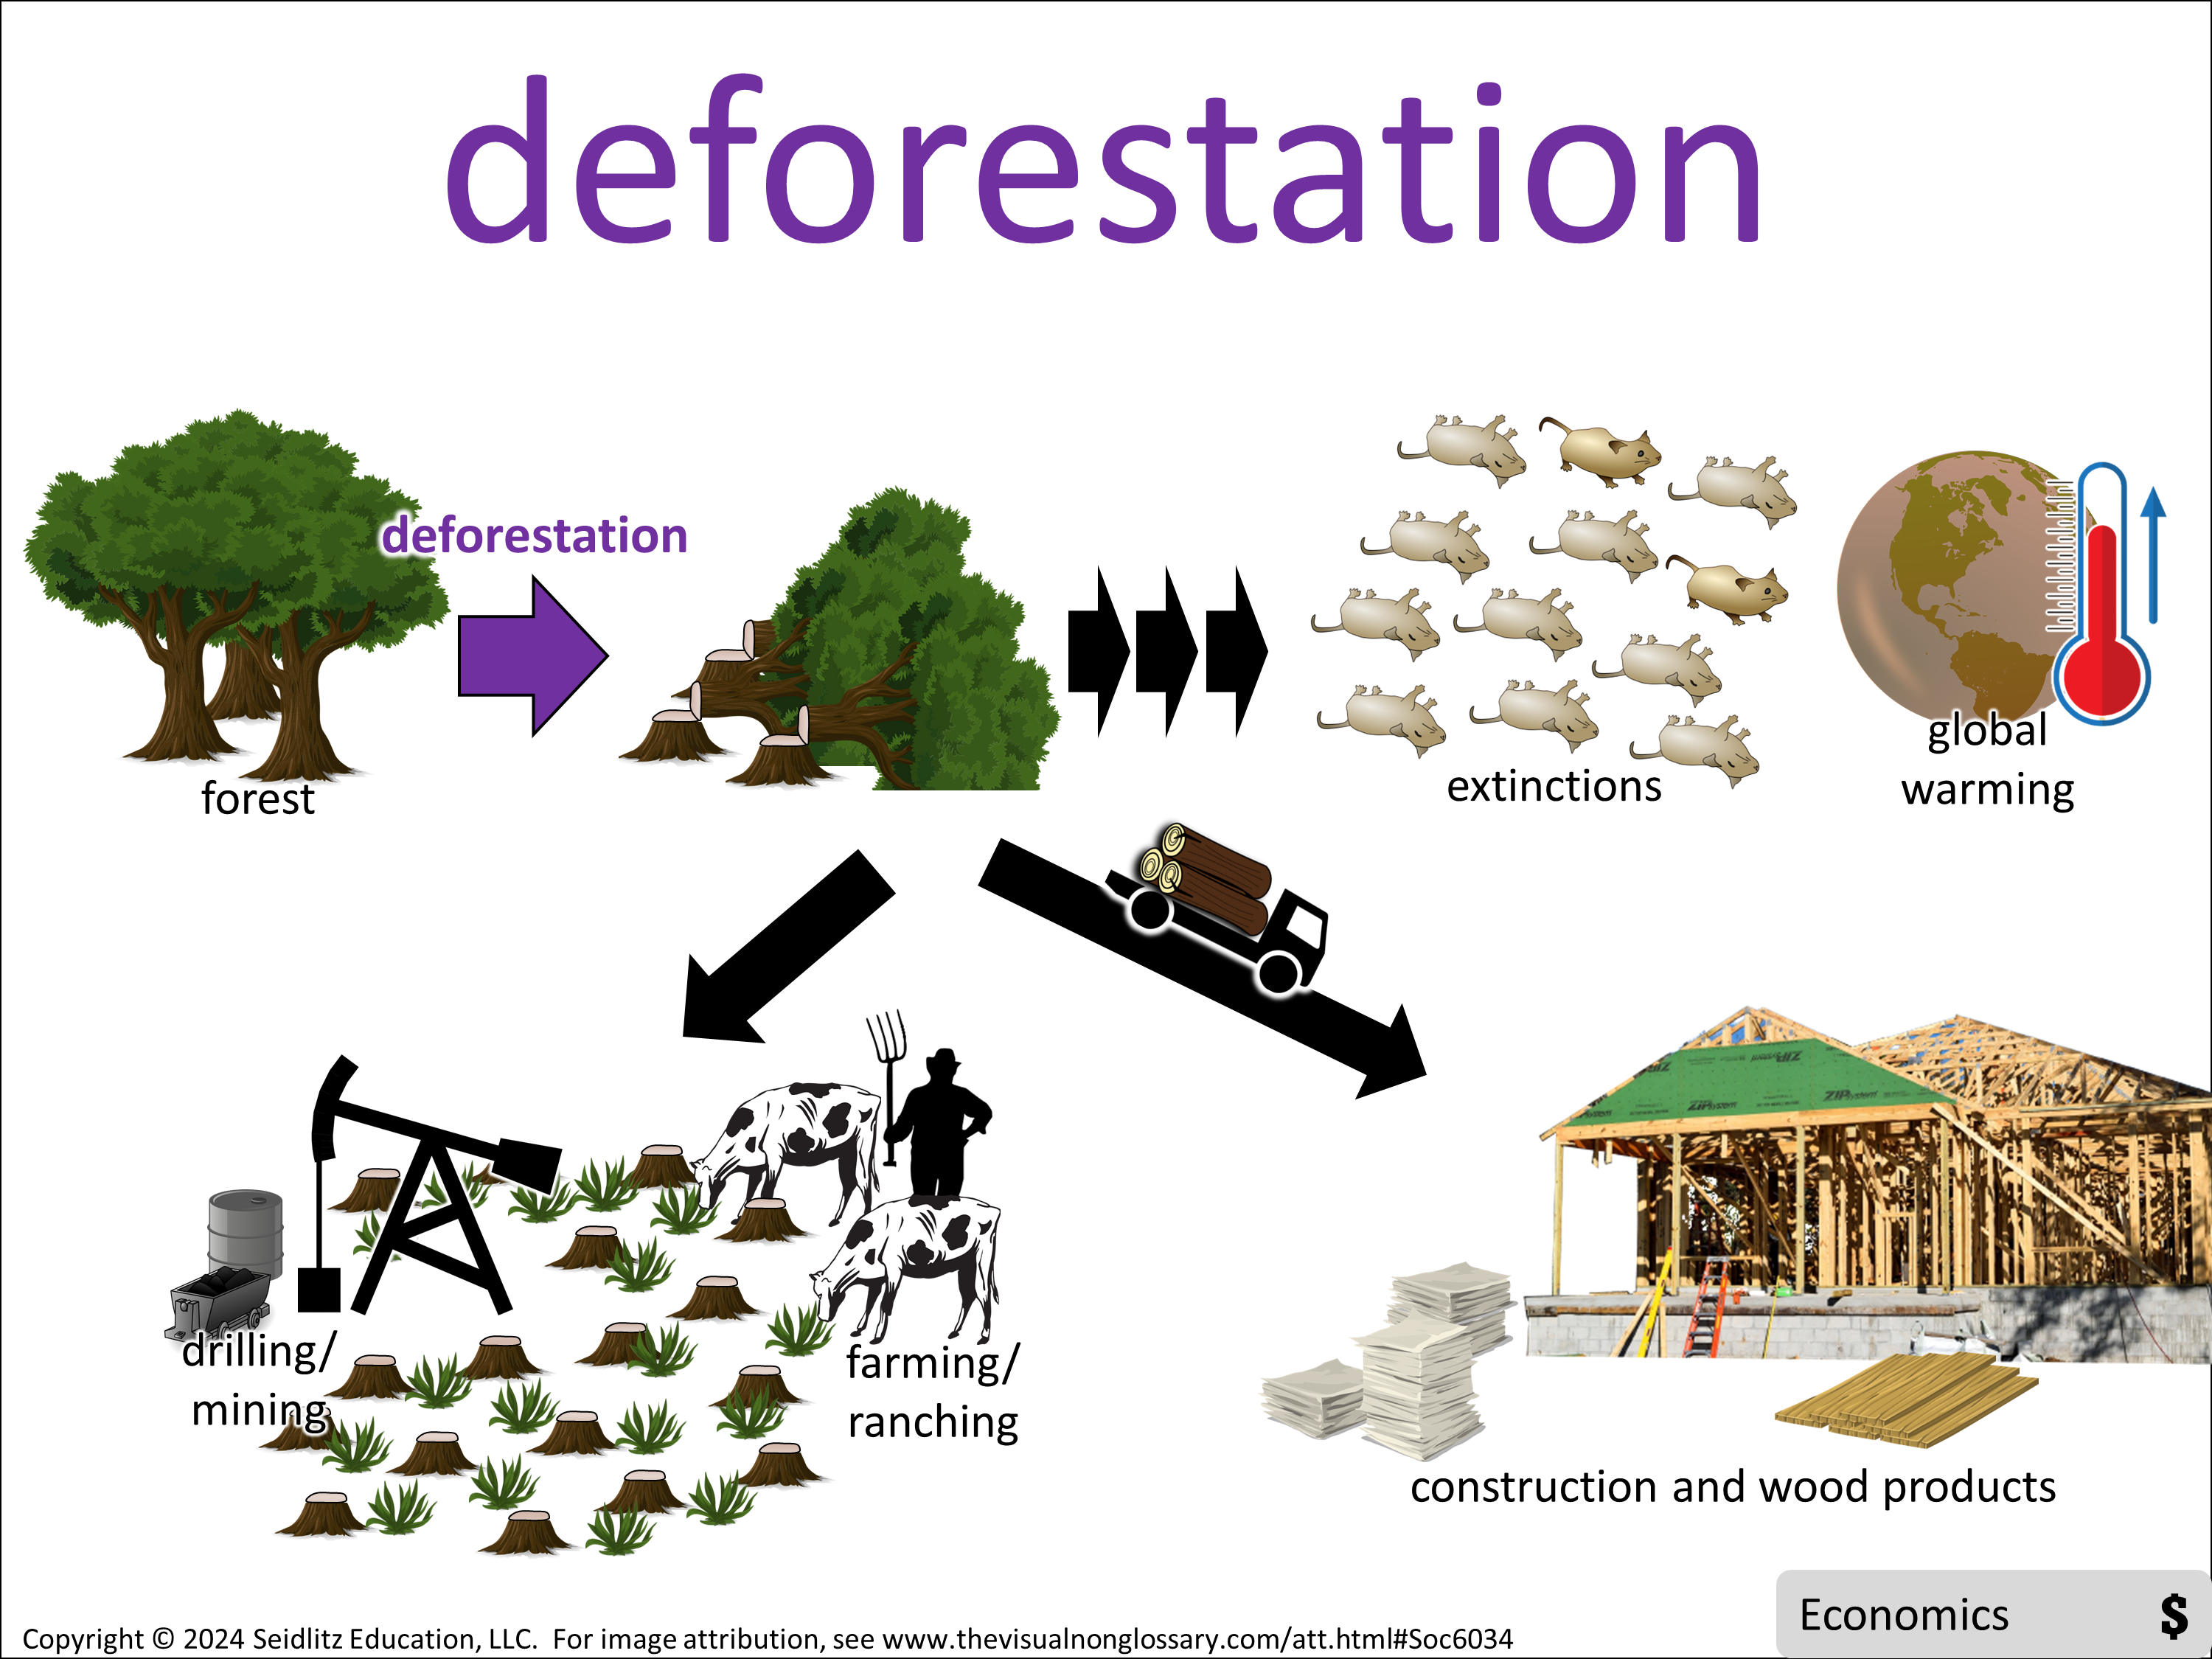
Class, let’s pronounce this word out loud: (read vocabulary word out loud slowly).
Can everybody _______(signal)? Think about this question. When you are ready to finish this sentence, _______(stem), show me by _______ (undo the signal).
You are going to share with _______ (share) The person in your group that will go first is _______ (share).
I’m going to _______ (assess). It’s okay if you say what you said or what your partner said, as long as you use ________ (vocabulary word) in a complete sentence. I recommend you use the sentence stem, ________ (stem).
Question: What is deforestation?
Stem: Deforestation is…
Signal:
Share:
Goes first
Assess:

Slide 8
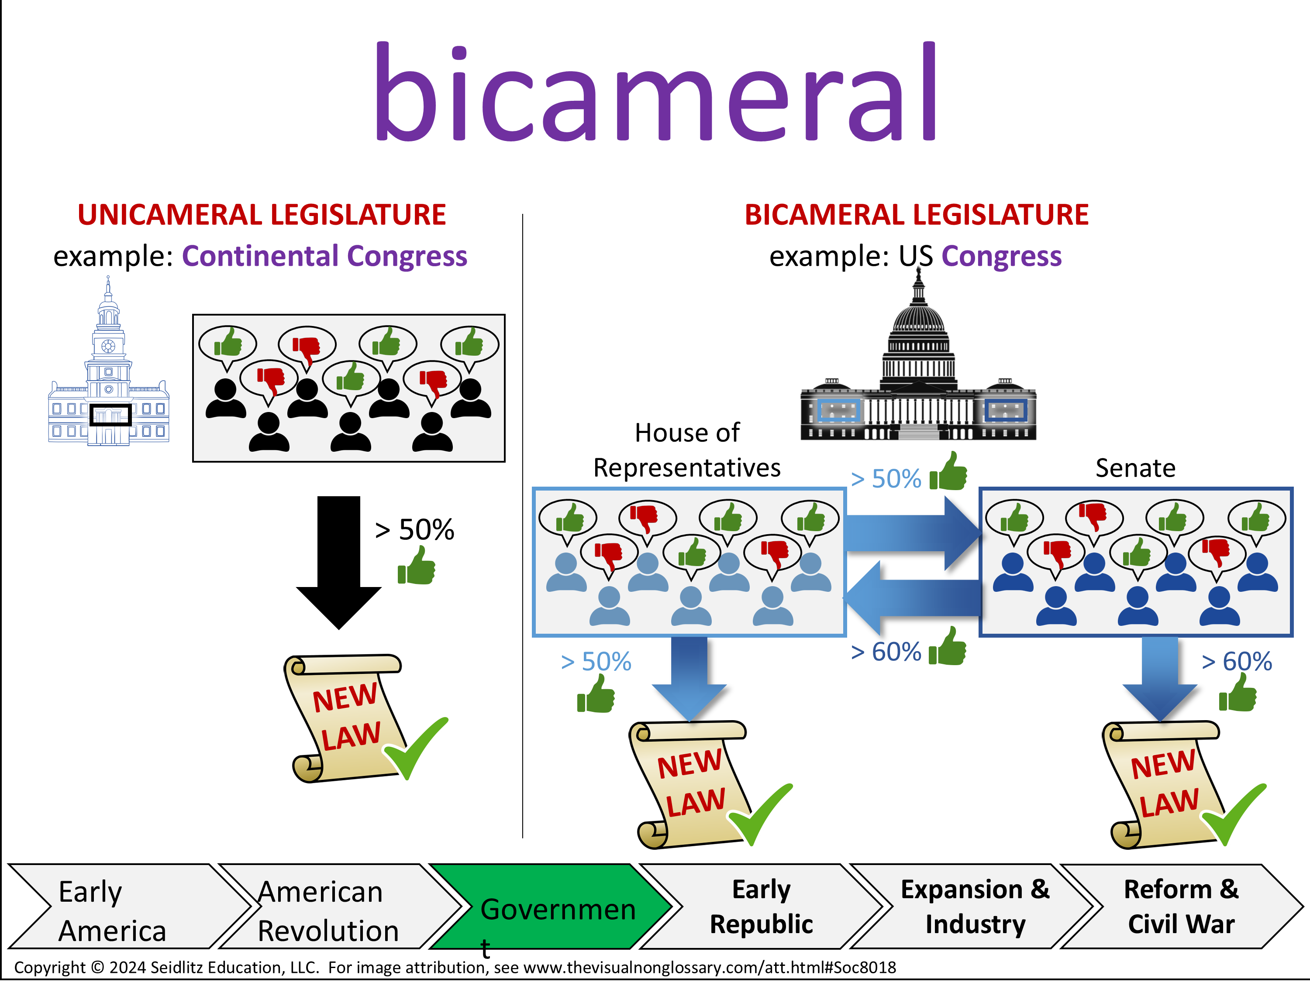
Class, let’s pronounce this word out loud: (read vocabulary word out loud slowly).
Can everybody _______(signal)? Think about this question. When you are ready to finish this sentence, _______(stem), show me by _______ (undo the signal).
You are going to share with _______ (share) The person in your group that will go first is _______ (share).
I’m going to _______ (assess). It’s okay if you say what you said or what your partner said, as long as you use ________ (vocabulary word) in a complete sentence. I recommend you use the sentence stem, ________ (stem).
Question: What does bicameral mean?
Stem: Bicameral means…
Signal:
Share:
Goes first
Assess:

Slide 9
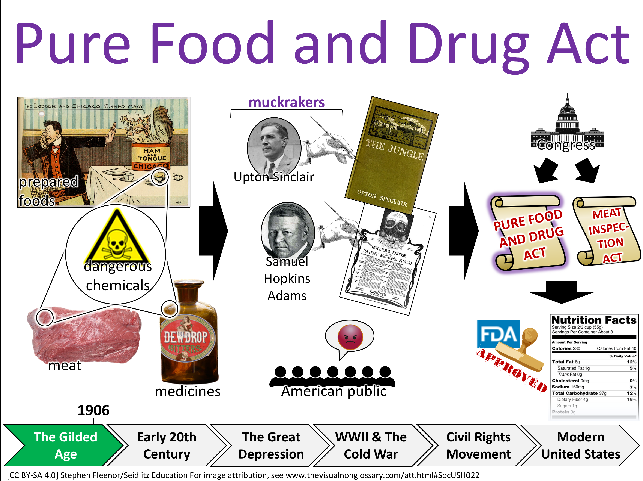
Class, let’s pronounce this word out loud: (read vocabulary word out loud slowly).
Can everybody _______(signal)? Think about this question. When you are ready to finish this sentence, _______(stem), show me by _______ (undo the signal).
You are going to share with _______ (share) The person in your group that will go first is _______ (share).
I’m going to _______ (assess). It’s okay if you say what you said or what your partner said, as long as you use ________ (vocabulary word) in a complete sentence. I recommend you use the sentence stem, ________ (stem).
Question: How was the Pure Food and Drug Act passed?
Stem: The Pure Food and Drug Act was passed…
Signal:
Share:
Goes first
Assess:

Slide 10
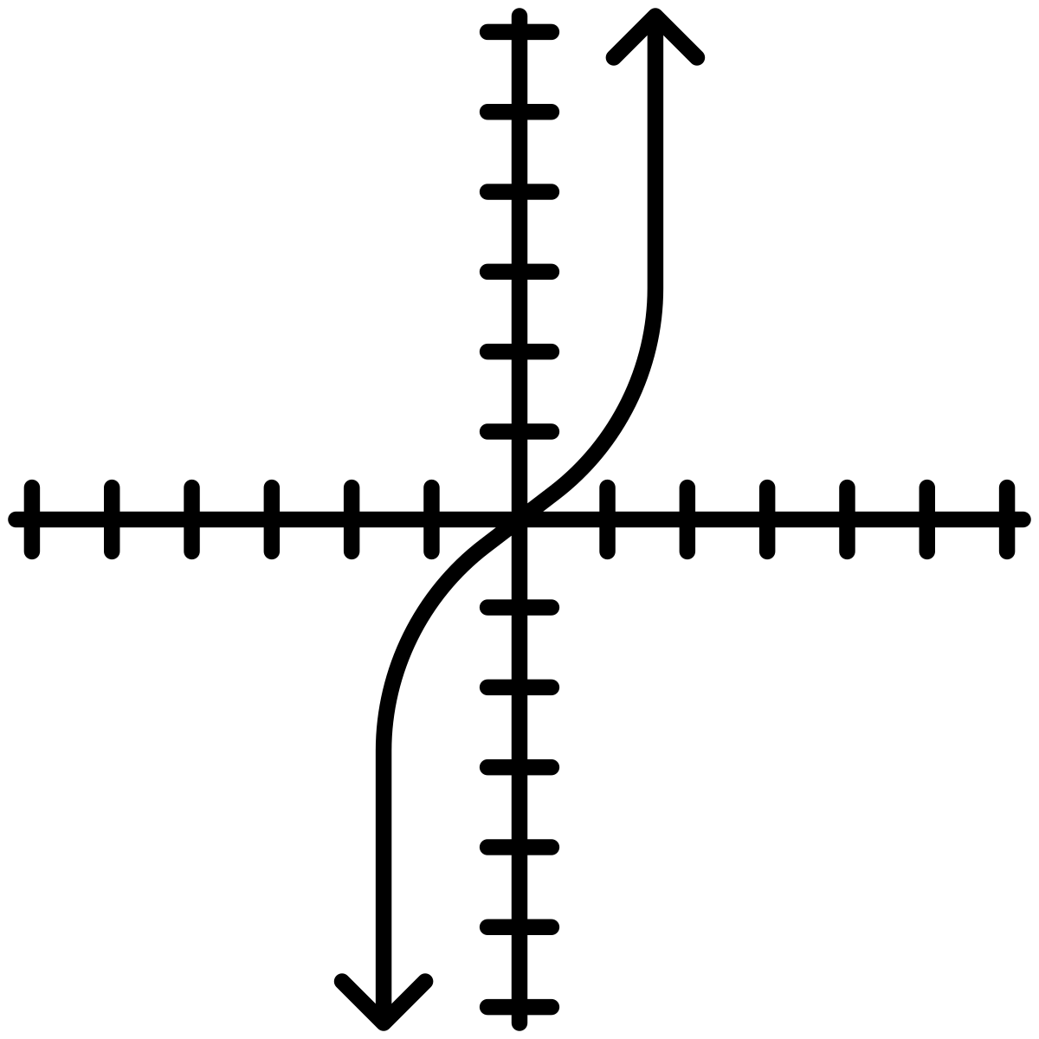



Math

Slide 11
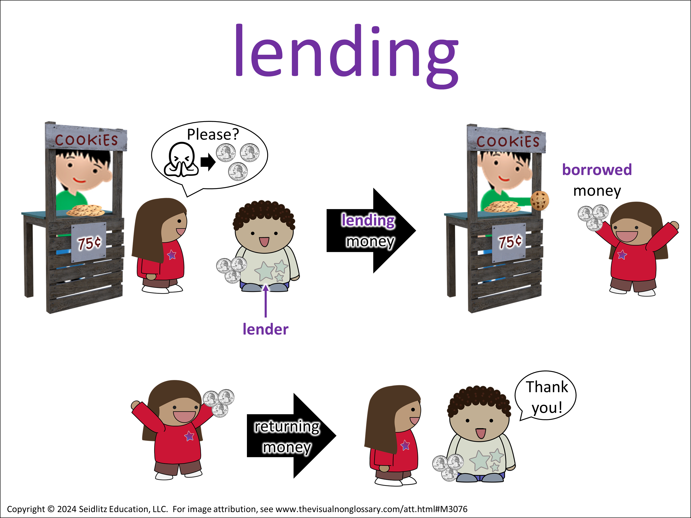
Class, let’s pronounce this word out loud: (read vocabulary word out loud slowly).
Can everybody _______(signal)? Think about this question. When you are ready to finish this sentence, _______(stem), show me by _______ (undo the signal).
You are going to share with _______ (share) The person in your group that will go first is _______ (share).
I’m going to _______ (assess). It’s okay if you say what you said or what your partner said, as long as you use ________ (vocabulary word) in a complete sentence. I recommend you use the sentence stem, ________ (stem).
Question: What is lending?
Stem: Lending is…
Signal:
Share:
Goes first
Assess:

Slide 12
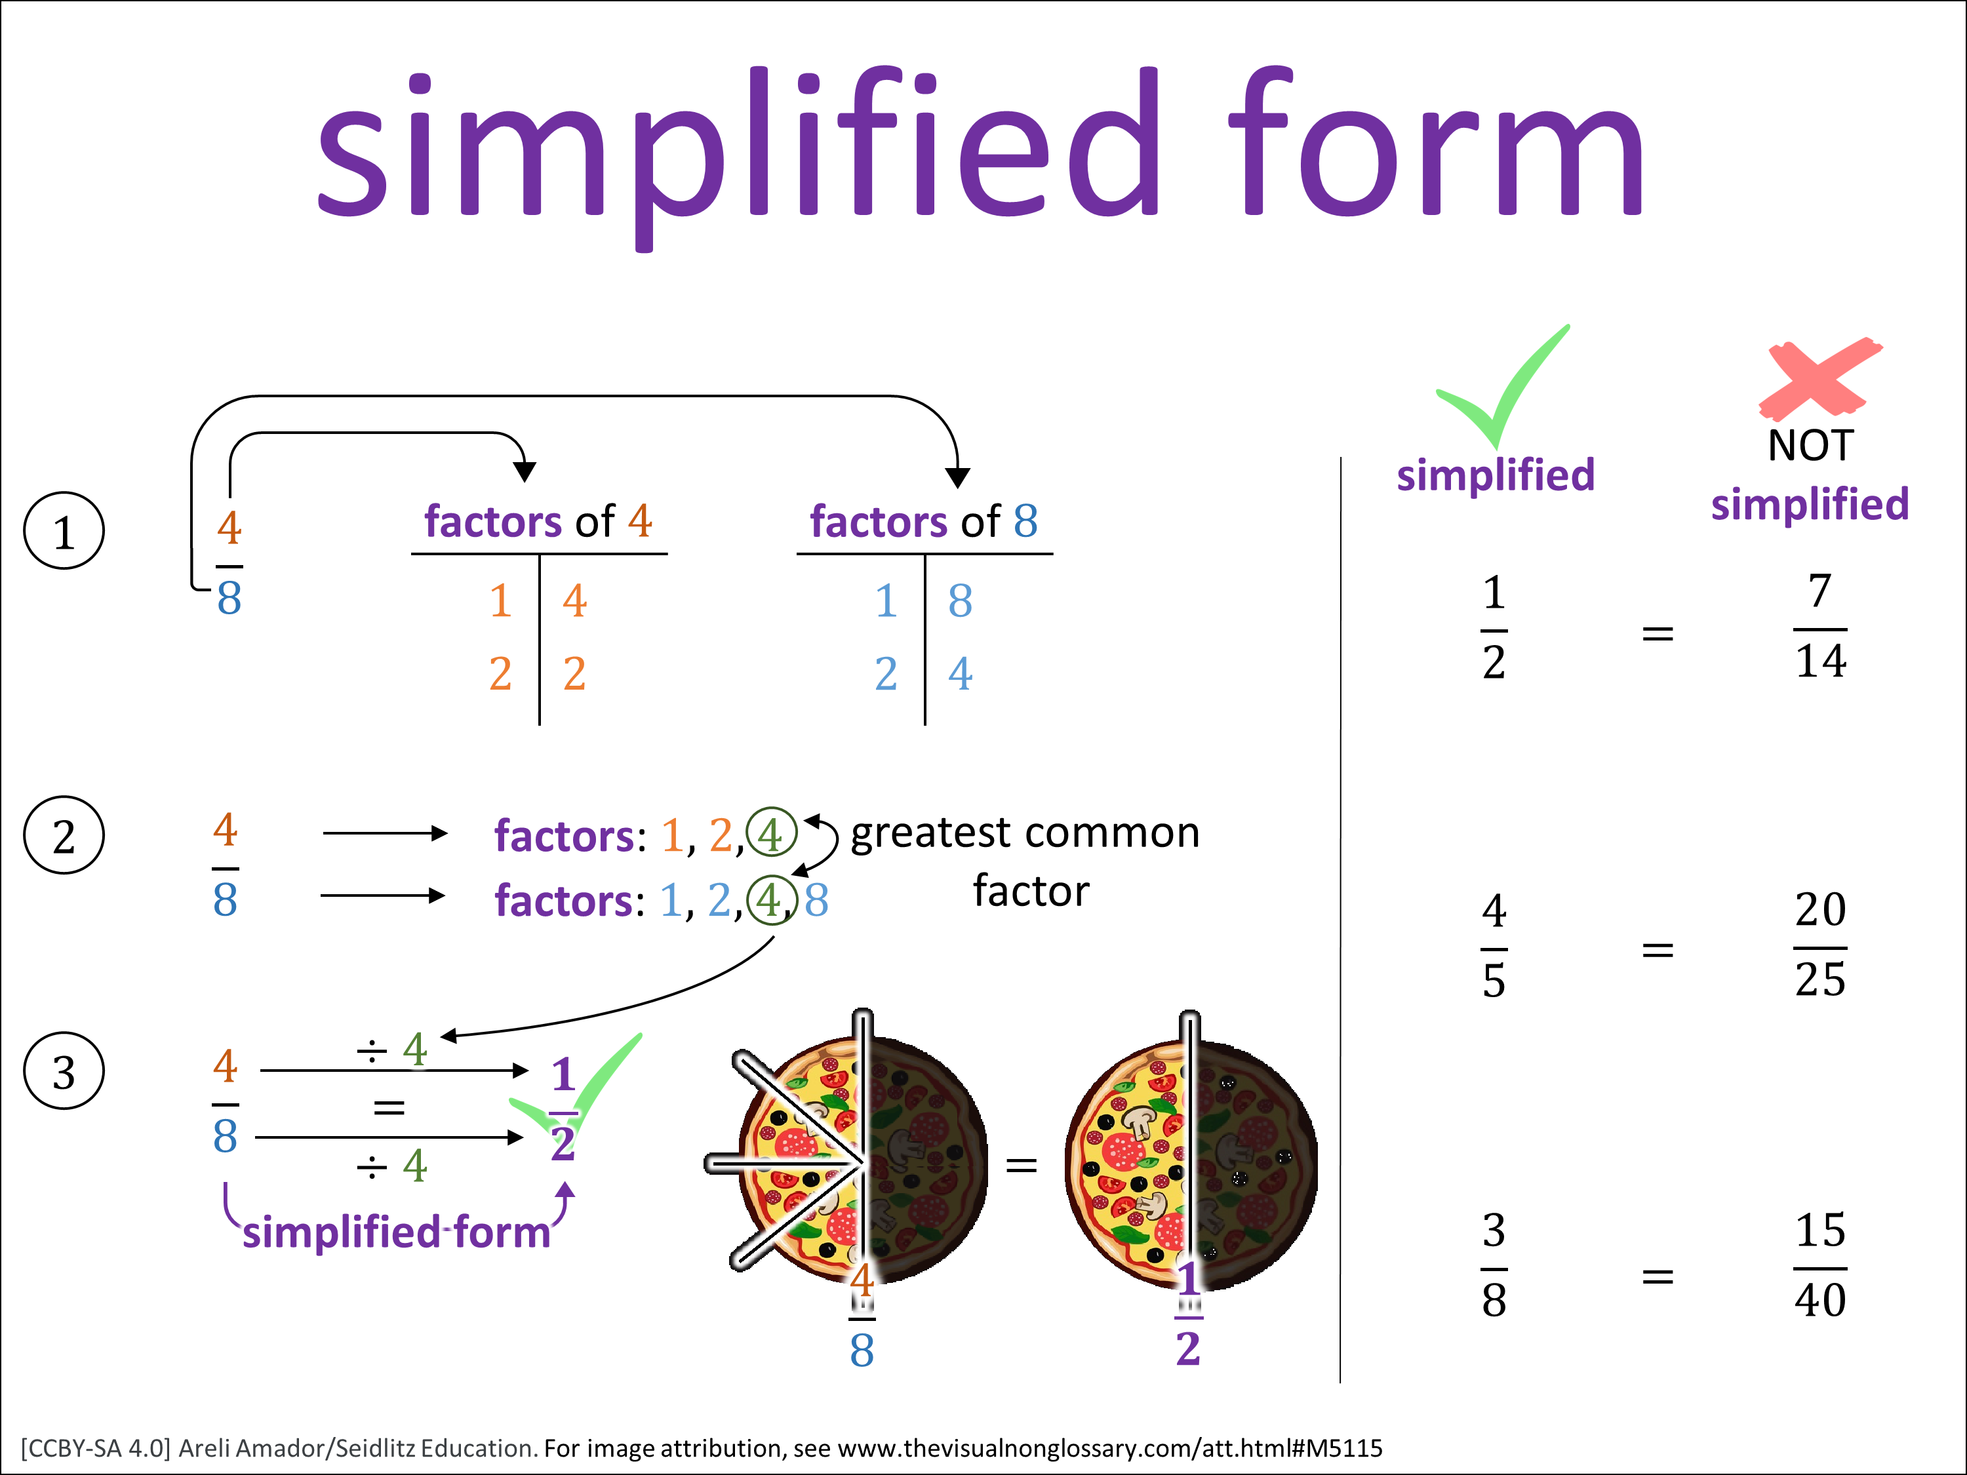
Class, let’s pronounce this word out loud: (read vocabulary word out loud slowly).
Can everybody _______(signal)? Think about this question. When you are ready to finish this sentence, _______(stem), show me by _______ (undo the signal).
You are going to share with _______ (share) The person in your group that will go first is _______ (share).
I’m going to _______ (assess). It’s okay if you say what you said or what your partner said, as long as you use ________ (vocabulary word) in a complete sentence. I recommend you use the sentence stem, ________ (stem).
Question: What is the simplified form?
Stem: The simplified form is…
Signal:
Share:
Goes first
Assess:

Slide 13
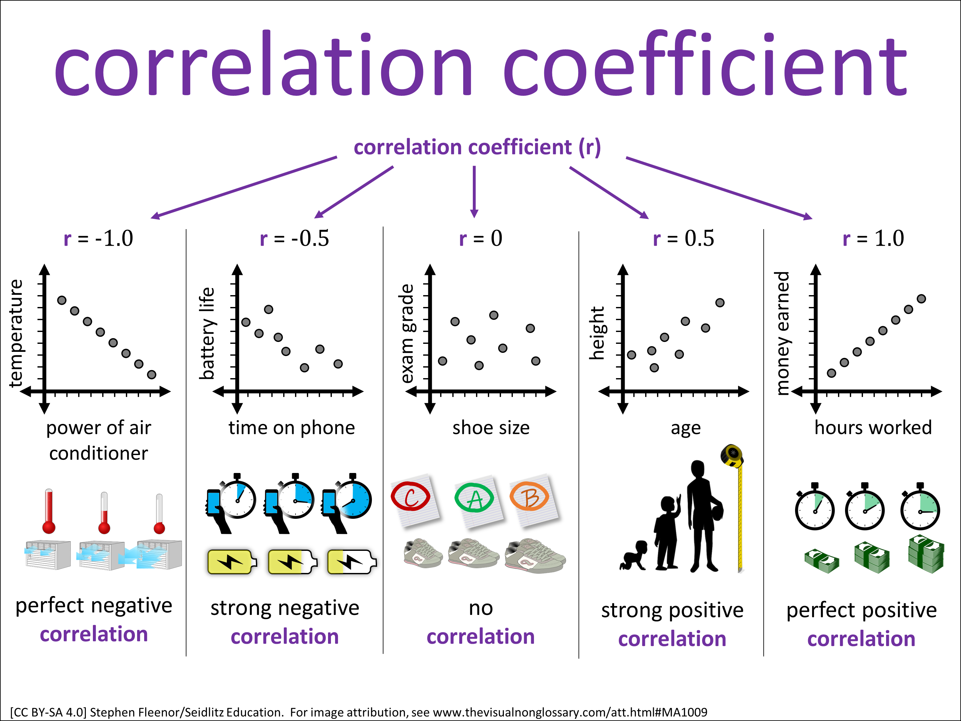
Class, let’s pronounce this word out loud: (read vocabulary word out loud slowly).
Can everybody _______(signal)? Think about this question. When you are ready to finish this sentence, _______(stem), show me by _______ (undo the signal).
You are going to share with _______ (share) The person in your group that will go first is _______ (share).
I’m going to _______ (assess). It’s okay if you say what you said or what your partner said, as long as you use ________ (vocabulary word) in a complete sentence. I recommend you use the sentence stem, ________ (stem).
Question: What does the correlation coefficient tell you?
Stem: The correlation coefficient tells you…
Signal:
Share:
Goes first
Assess:

